Slide 1
All content in this week’s tutorial (both Sheldon and Xin Xia) will not in your exam.
You see this slide because you come here early. Let’s wait for other students to come

Slide 2

INFS7450 SOCIAL MEDIA ANALYTICS Tutorial Week 10
Xiangguo (Sheldon) Sun
School of ITEE
The University of Queensland

Slide 3
Summary of Project 1
Ground truth:
nx.betweenness_centrality(G)
nx.pagerank(G)
All the parameters are set up by default.
Python 3.6, network 2.3
Node betweenness:
[107, 1684, 3437, 1912, 1085, 0, 698, 567, 58, 428]
Pagerank:
[3437, 107, 1684, 0, 1912, 348, 686, 3980, 414, 698]
We don’t care about the orders.
Ground truth means ground truth. There's no complete truth in our life. Ground truth means the baseline or the relatively objective criterion. Tt is unique for the given task. No matter whether the python version impacts, there is only one version of ground truth.
Some students may have different nodes when it comes to 10th and 11th, because they have very similar values. If you generate 9 of the above, you can also get full mark in the result part.
Notes:
Some students may have different nodes when it comes to 10th and 11th , because they have very similar values.
If you generate 9 of them, you can also get full mark in the result part.

Slide 4
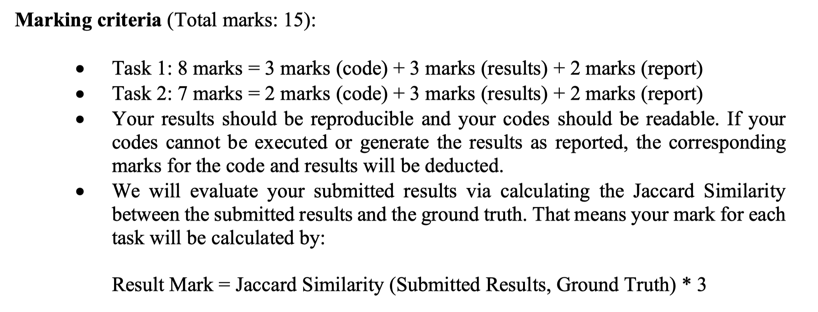
Summary of Project 1
Notes:
Some students may have different nodes when it comes to 10th and 11th , because they have very similar values.
If you generate 9 of them, you can also get full mark in the result part.

Slide 5
Some excellent work from our students!
Student: 44749826 Miss Jawaher
PART ONE: results
107 1684 3437 1912 1085 0 698 567 58 428
107 3437 0 1684 1912 348 414 3980 686 698
[107, 1684, 3437, 1912, 1085, 0, 698, 567, 58, 428]
[3437, 107, 1684, 0, 1912, 348, 686, 3980, 414, 698]
The results are consist with our ground truth
Notes:
107, 1684, 3437, 1912, 1085, 0, 698, 567, 58, 428]
[3437, 107, 1684, 0, 1912, 348, 686, 3980, 414, 698]

Slide 6
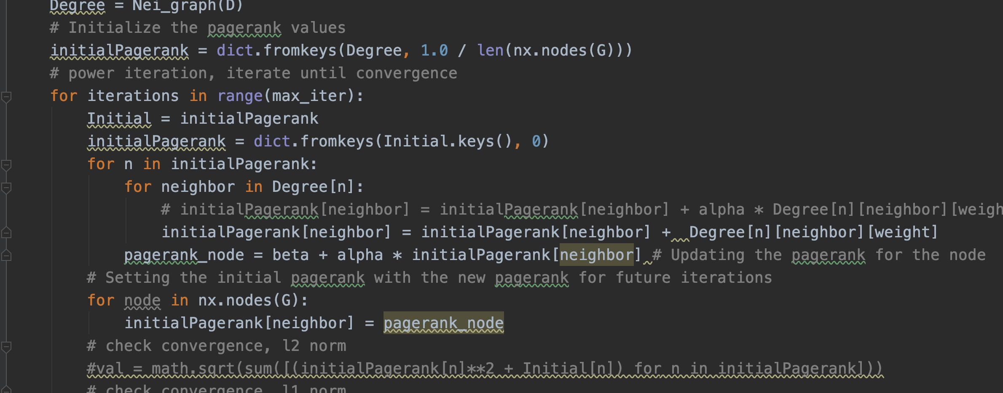
Some excellent work from our students!
Student: 44749826 Miss Jawaher
PART TWO: Codes
The codes are readable and she gave me some annotation so that I can understand her idea easily.
The source codes are reproductive.
Notes:
107, 1684, 3437, 1912, 1085, 0, 698, 567, 58, 428]
[3437, 107, 1684, 0, 1912, 348, 686, 3980, 414, 698]

Slide 7
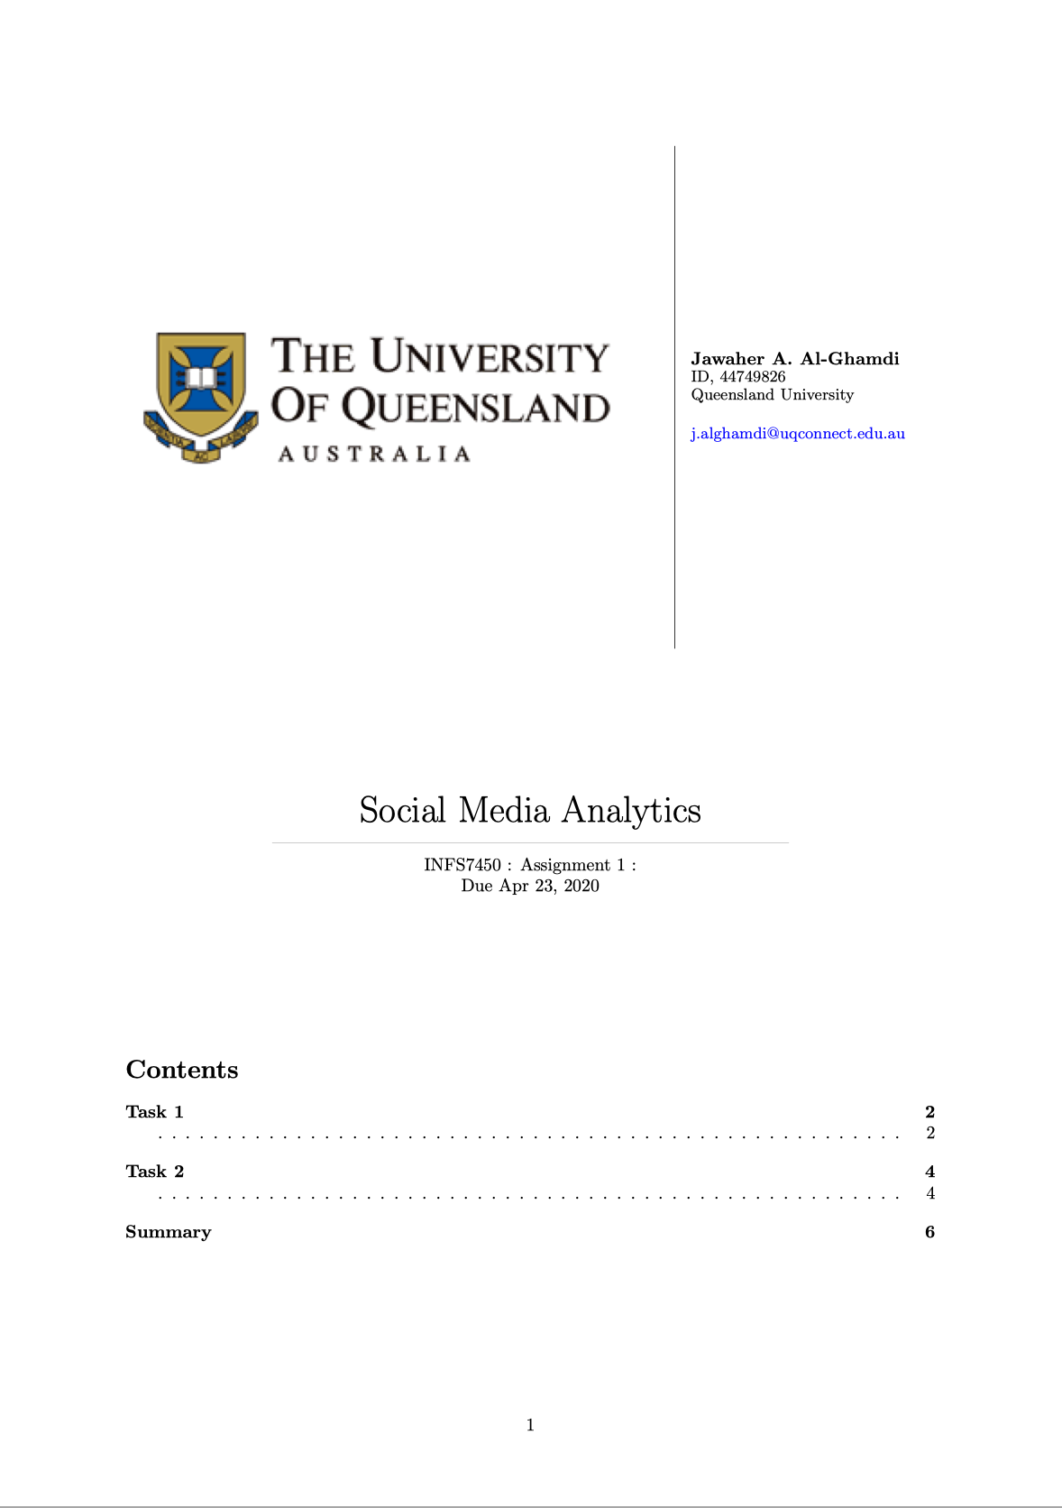
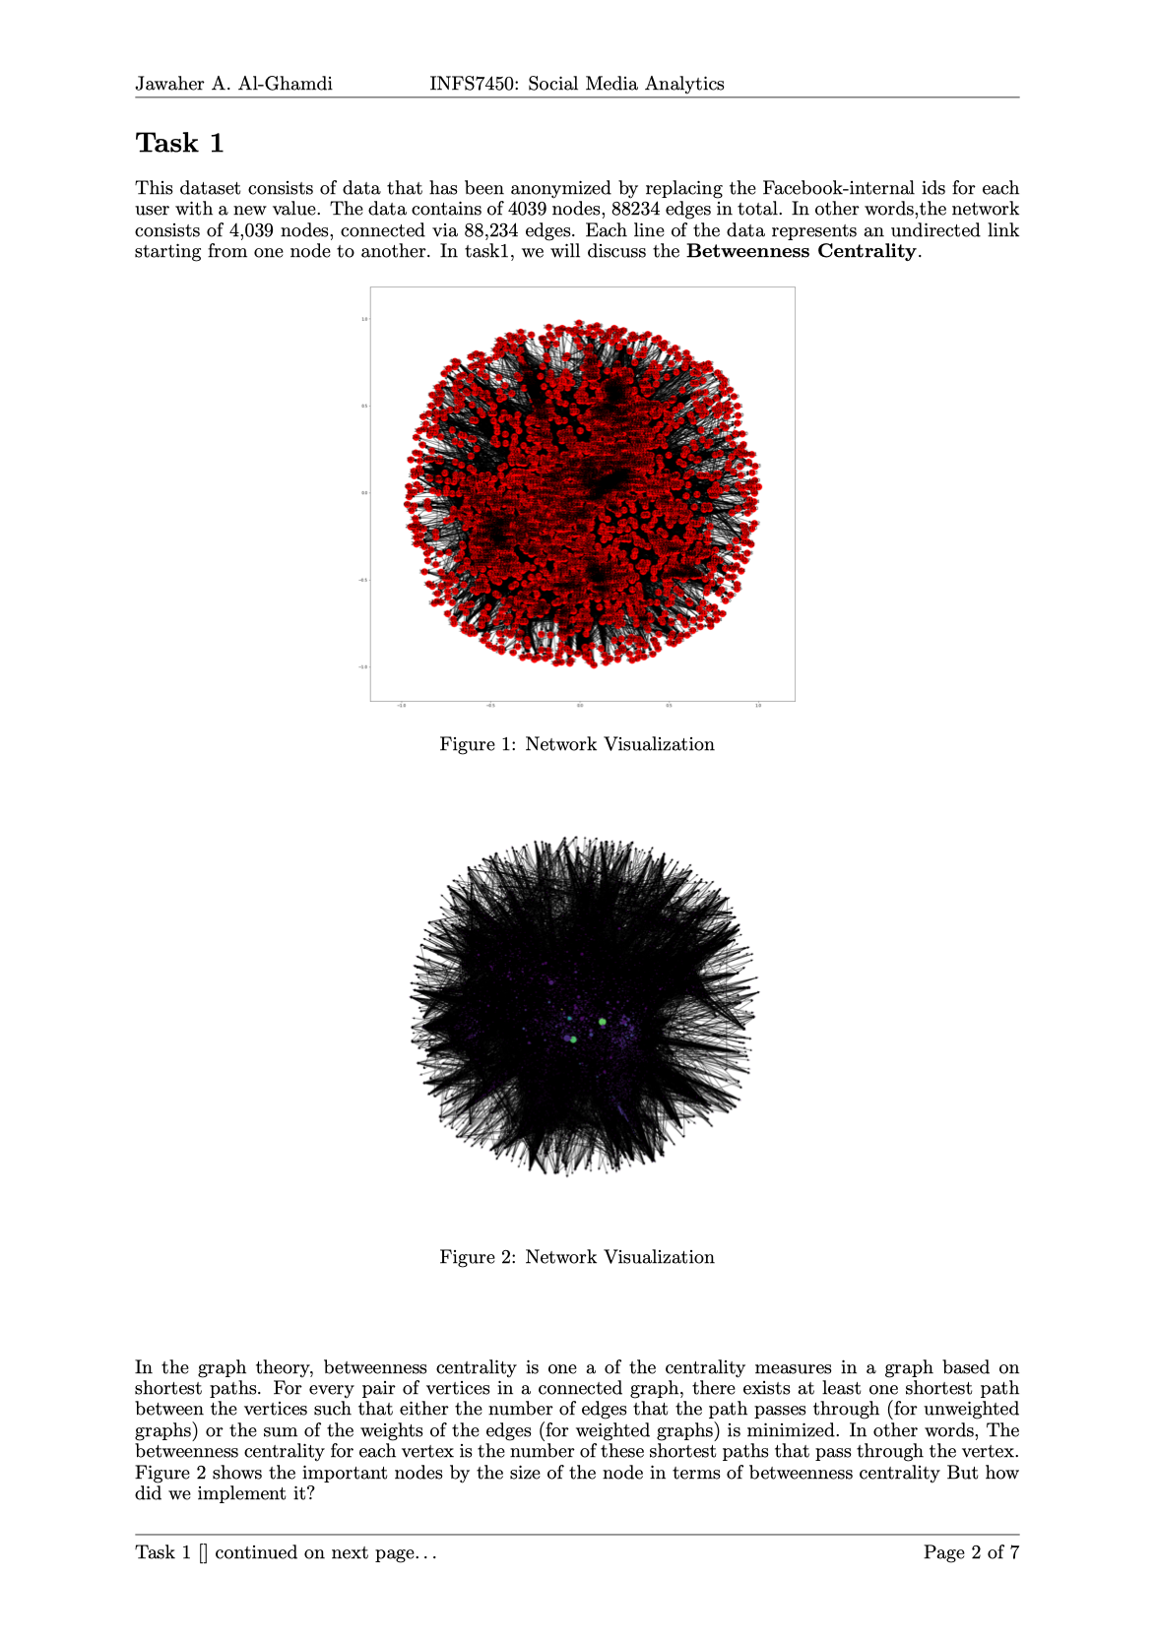
Some excellent work from our students!
Student: 44749826 Miss Jawaher
PART THREE: REPORT
Notes:
107, 1684, 3437, 1912, 1085, 0, 698, 567, 58, 428]
[3437, 107, 1684, 0, 1912, 348, 686, 3980, 414, 698]

Slide 8
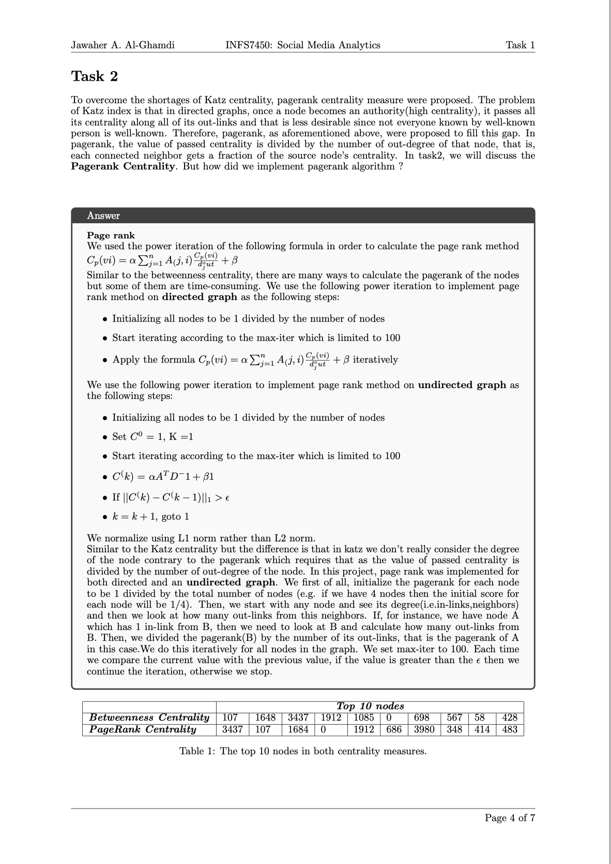
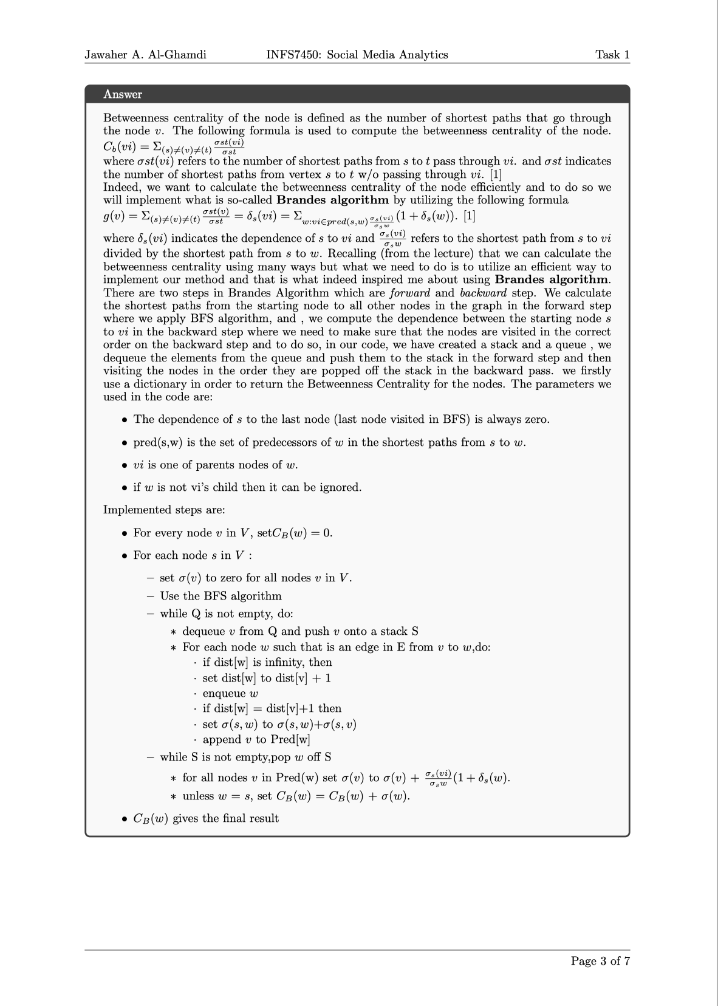
Some excellent work from our students!
Student: 44749826 Miss Jawaher
PART THREE: REPORT
Notes:
107, 1684, 3437, 1912, 1085, 0, 698, 567, 58, 428]
[3437, 107, 1684, 0, 1912, 348, 686, 3980, 414, 698]

Slide 9
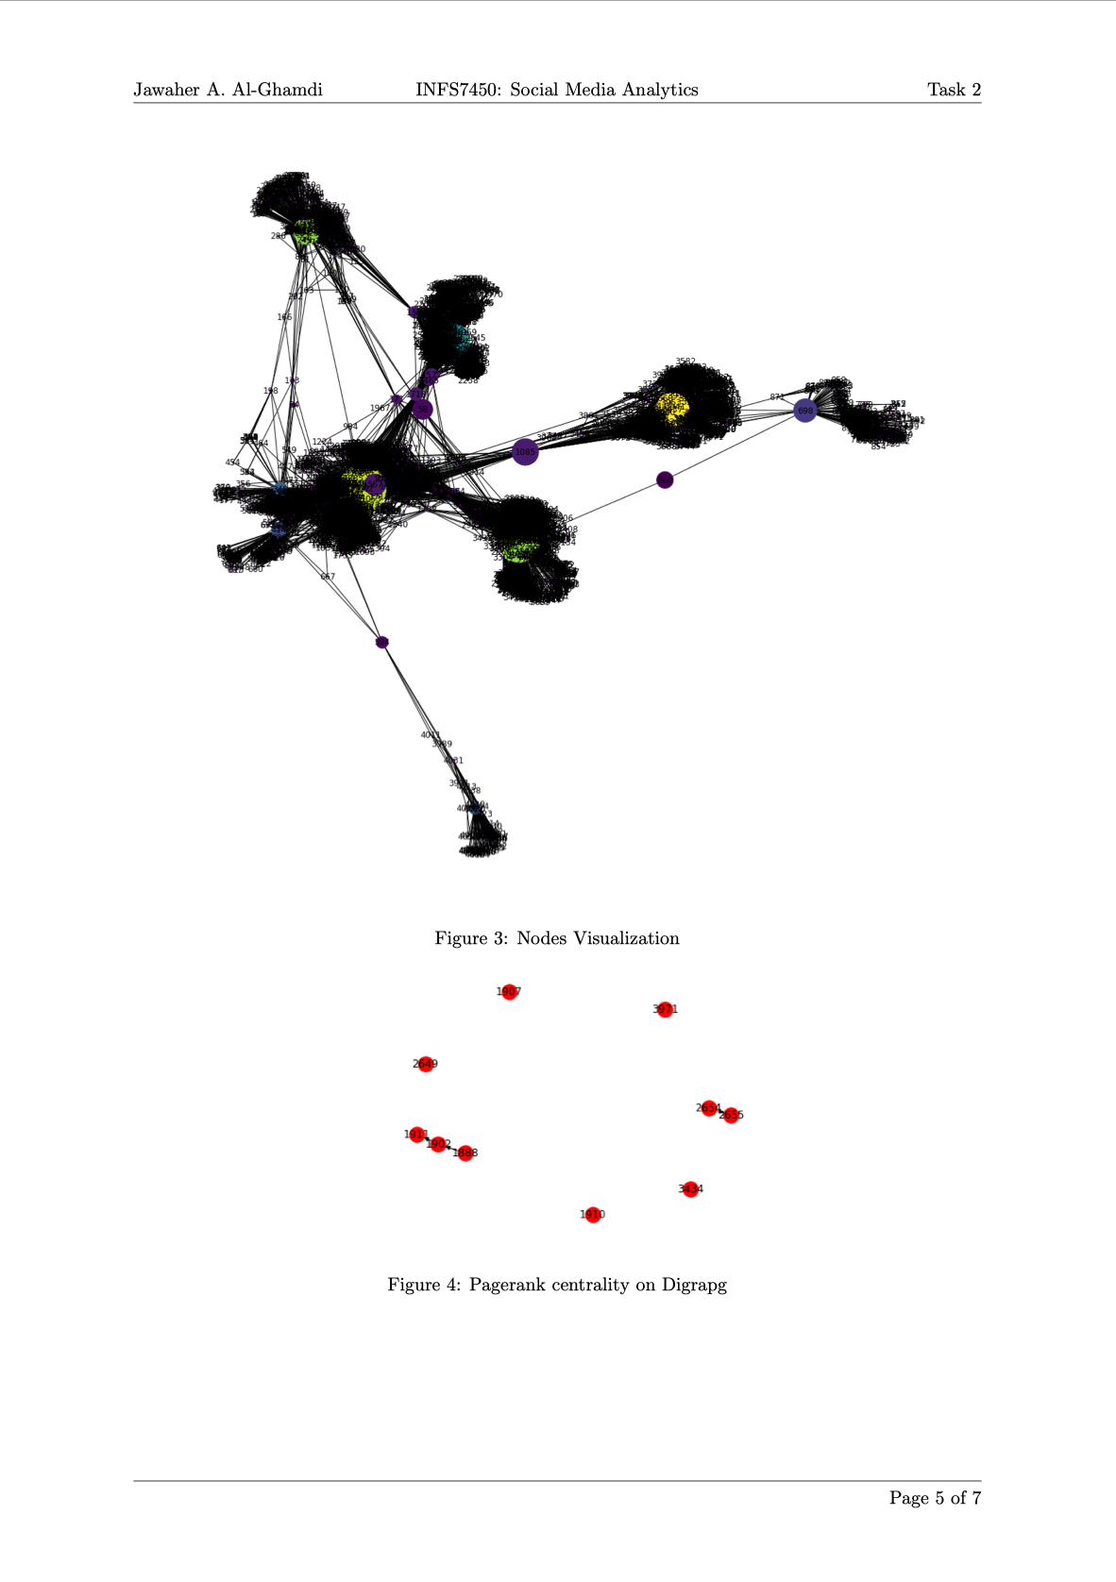
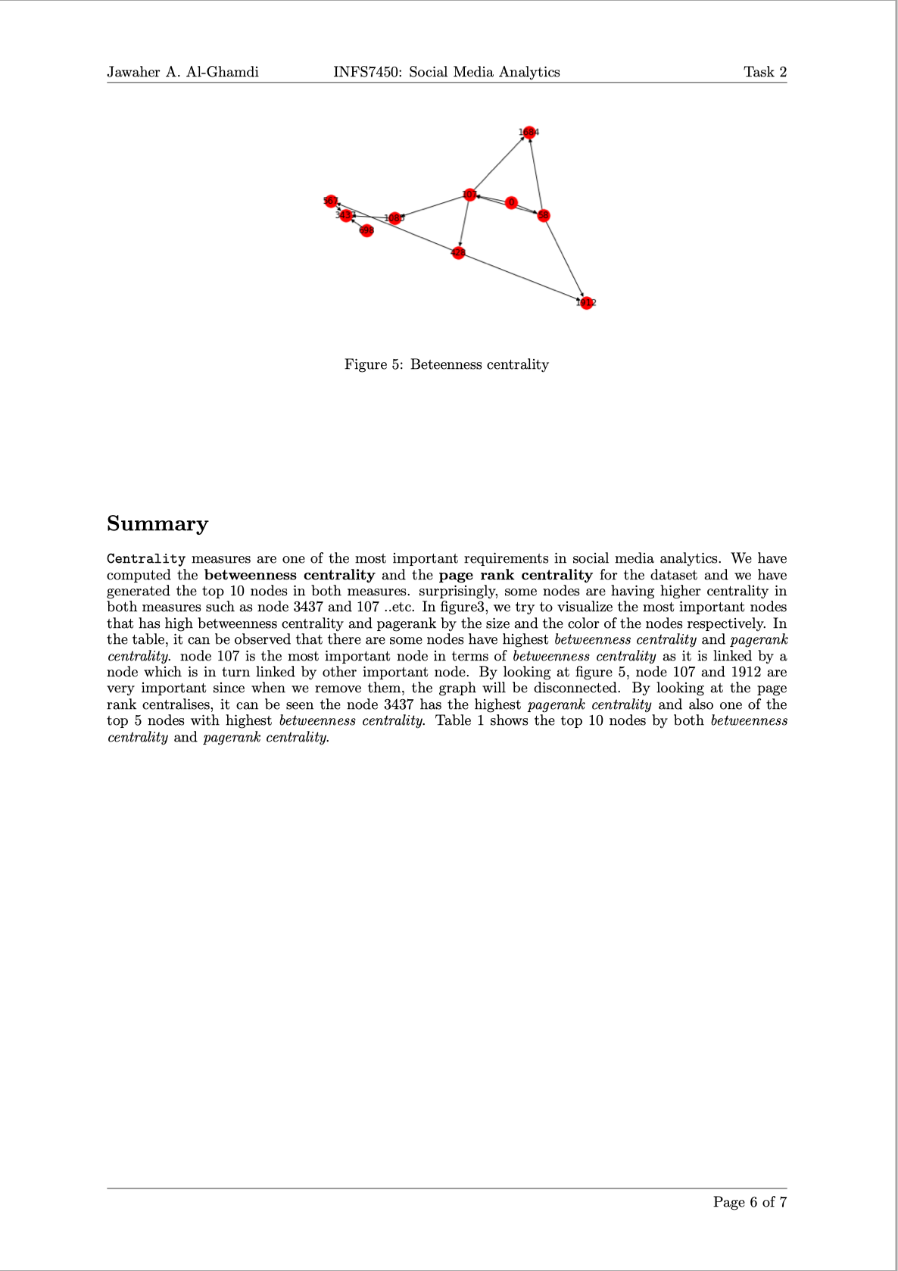
Some excellent work from our students!
Student: 44749826 Miss Jawaher
PART THREE: REPORT
Notes:
107, 1684, 3437, 1912, 1085, 0, 698, 567, 58, 428]
[3437, 107, 1684, 0, 1912, 348, 686, 3980, 414, 698]

Slide 10
Some excellent work from our students!
Student: 44749826 Miss Jawaher
Any shortcoming?
The report didn’t follow our template. However, she supplied with another version of report using our template. Besides, I don’t think this report mislead my understanding. Actually the student’s own format is more professional than our template. So it doesn’t reduce my good impression.
The codes are based on Functional Programming. Although we prefer to OOP (object-oriented programming), but our project is small-scale and relatively simple, which means functional programming is also a good choice. So it doesn’t reduce my good impression.
Highlight?
The report gave me deep impression. She did a lot of work and she also draw the graph and her results.
Her code is independent with existing work and readable.
The results are good enough.
In summary, I’d like to give full mark of her project work
Notes:
107, 1684, 3437, 1912, 1085, 0, 698, 567, 58, 428]
[3437, 107, 1684, 0, 1912, 348, 686, 3980, 414, 698]

Slide 11
Some excellent work from our students!
Student: 45209167 Mr. Haifeng Hu
PART ONE: results
107 1684 3437 1912 1085 0 698 567 58 428
3437 107 1684 0 1912 348 686 3980 414 483
[107, 1684, 3437, 1912, 1085, 0, 698, 567, 58, 428]
[3437, 107, 1684, 0, 1912, 348, 686, 3980, 414, 698]
The results are consist with our ground truth
Although there exist only one different, but as we previously said, he can also get full mark in this part
Notes:
107, 1684, 3437, 1912, 1085, 0, 698, 567, 58, 428
3437, 107, 1684, 0, 1912, 348, 686, 3980, 414, 483

Slide 12
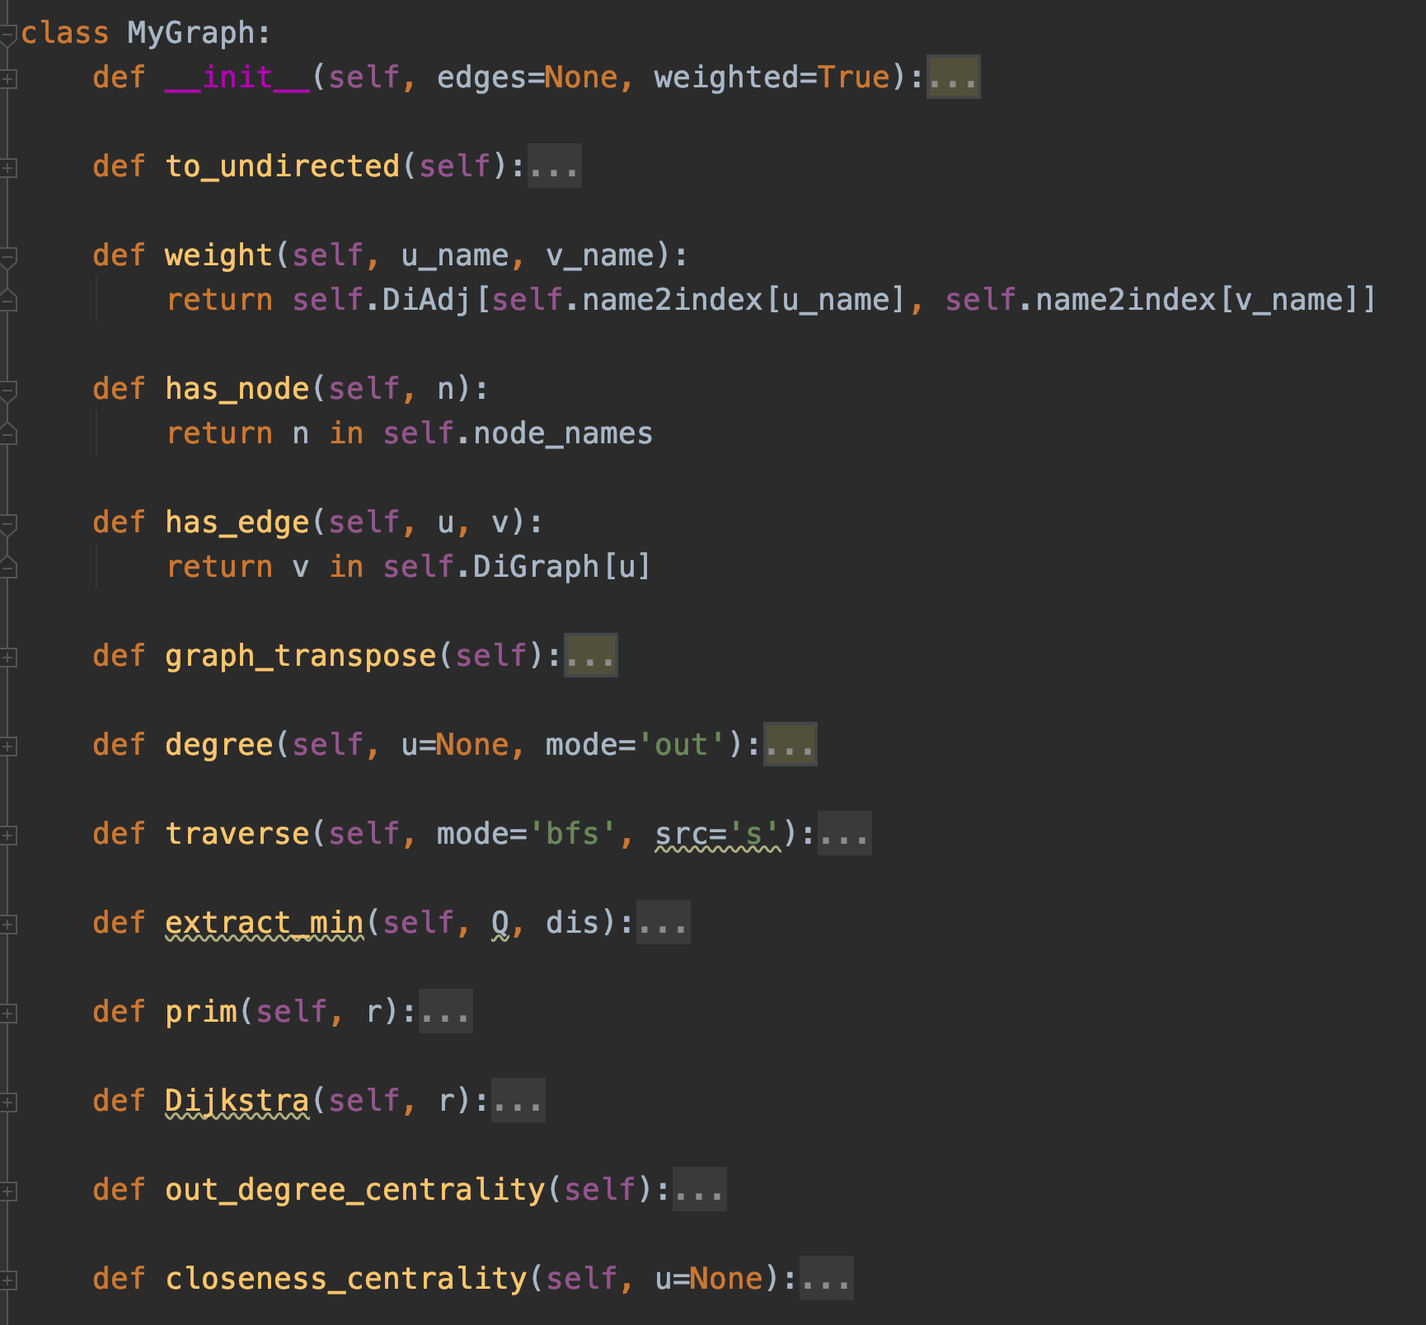
Some excellent work from our students!
Student: 45209167 Mr. Haifeng Hu
PART TWO: Codes
The codes are highly independent of other third part libraries.
They are based on our previous tutorial (graph_me.py), and they didn’t use any valid function from networkX!
The source codes are reproductive, OOP, and readable.
Notes:
107, 1684, 3437, 1912, 1085, 0, 698, 567, 58, 428]
[3437, 107, 1684, 0, 1912, 348, 686, 3980, 414, 698]

Slide 13
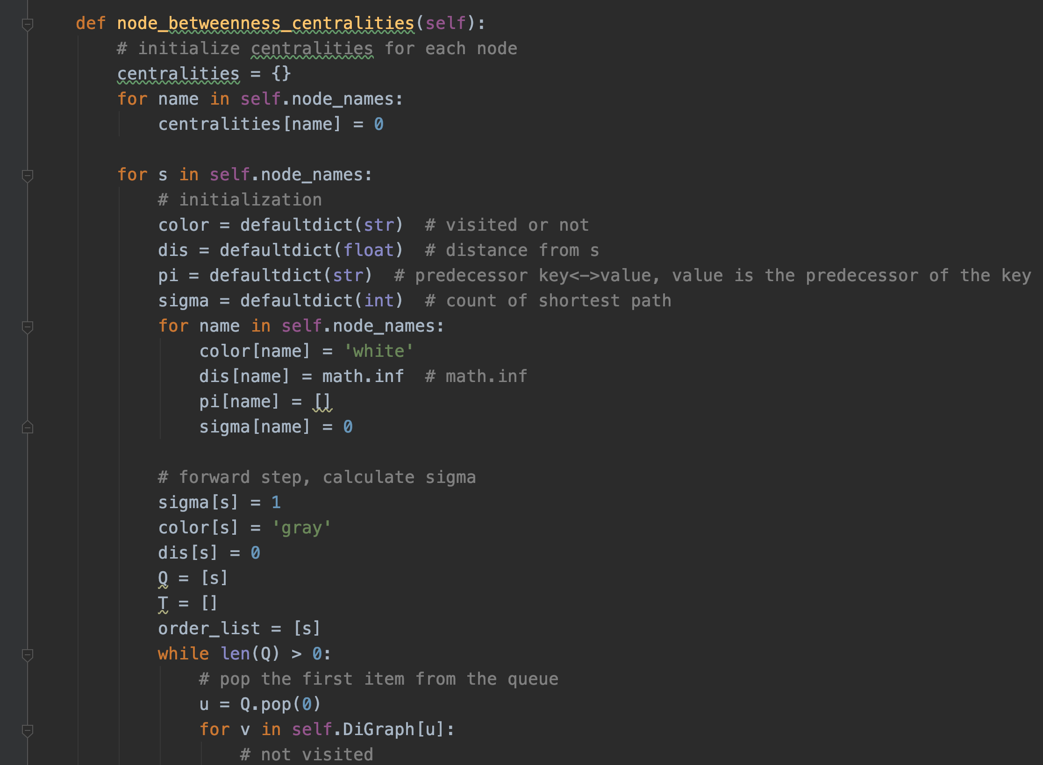
Some excellent work from our students!
Student: 44749826 Miss Jawaher
PART TWO: Codes
The codes are highly independent of other third part libraries.
They are based on our previous tutorial (graph_me.py), and they didn’t use any valid function from networkX!
The source codes are reproductive, OOP, and readable.
Notes:
107, 1684, 3437, 1912, 1085, 0, 698, 567, 58, 428]
[3437, 107, 1684, 0, 1912, 348, 686, 3980, 414, 698]

Slide 14
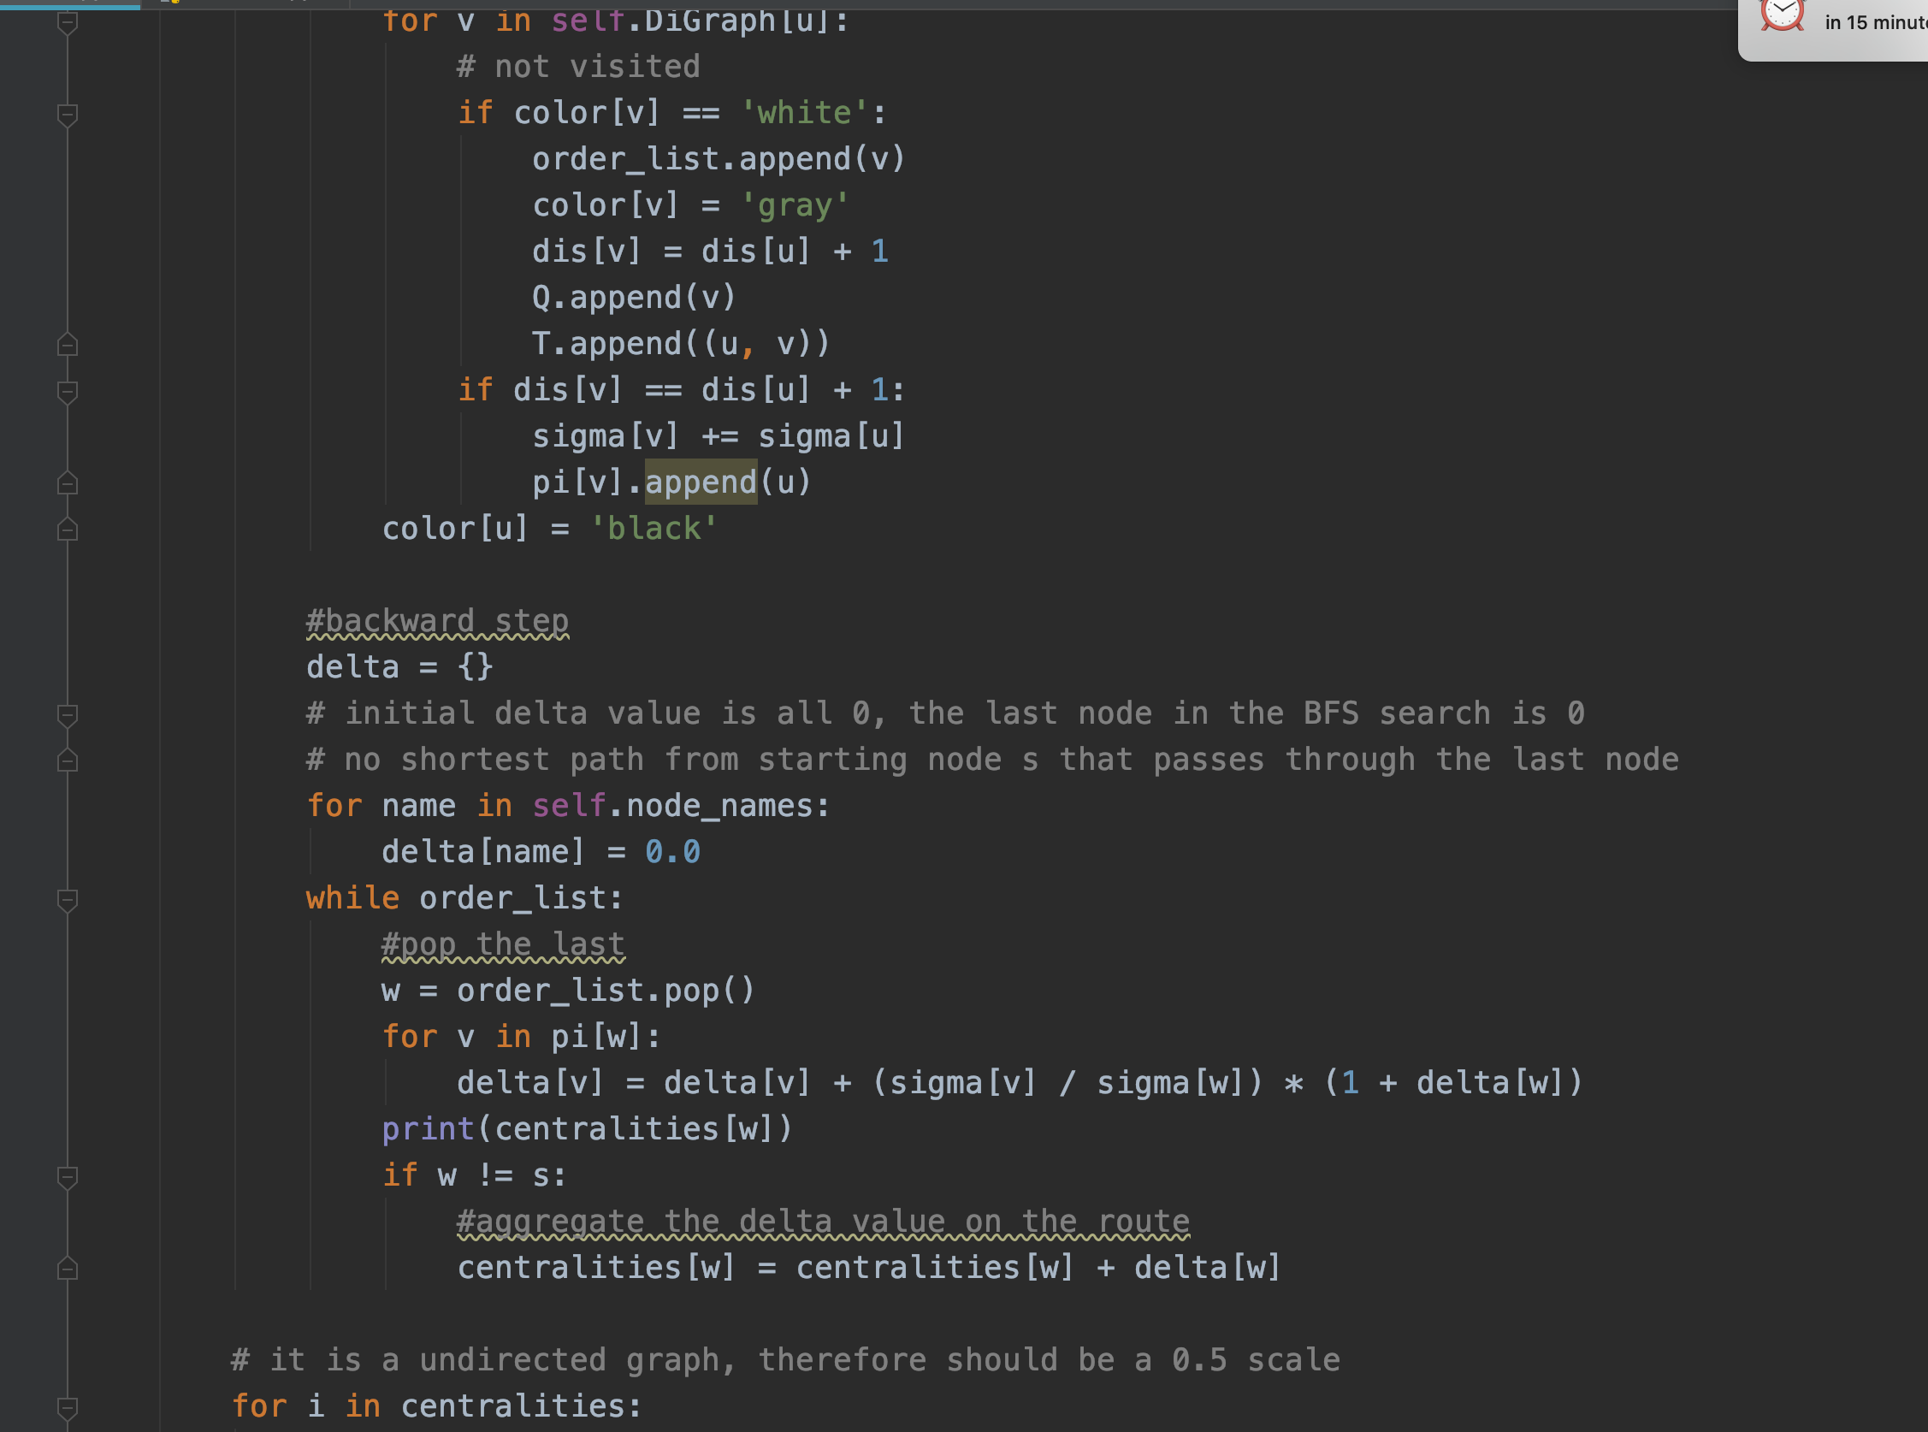
Some excellent work from our students!
Student: 44749826 Miss Jawaher
PART TWO: Codes
The codes are highly independent of other third part libraries.
They are based on our previous tutorial (graph_me.py), and they didn’t use any valid function from networkX!
The source codes are reproductive, OOP, and readable.
Notes:
107, 1684, 3437, 1912, 1085, 0, 698, 567, 58, 428]
[3437, 107, 1684, 0, 1912, 348, 686, 3980, 414, 698]

Slide 15
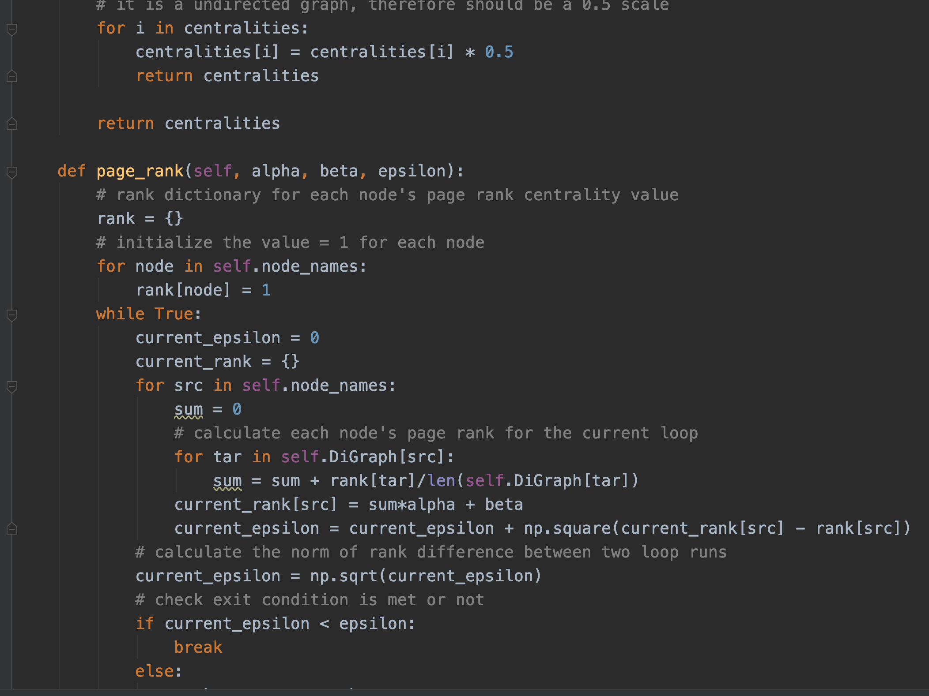
Some excellent work from our students!
Student: 44749826 Miss Jawaher
PART TWO: Codes
The codes are highly independent of other third part libraries.
They are based on our previous tutorial (graph_me.py), and they didn’t use any valid function from networkX!
The source codes are reproductive, OOP, and readable.
Notes:
107, 1684, 3437, 1912, 1085, 0, 698, 567, 58, 428]
[3437, 107, 1684, 0, 1912, 348, 686, 3980, 414, 698]

Slide 16
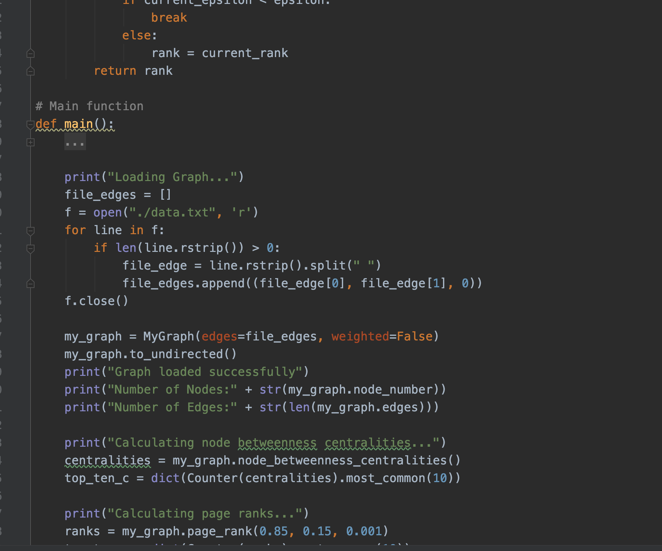
Some excellent work from our students!
Student: 44749826 Miss Jawaher
PART TWO: Codes
The codes are highly independent of other third part libraries.
They are based on our previous tutorial (graph_me.py), and they didn’t use any valid function from networkX!
The source codes are reproductive, OOP, and readable.
Notes:
107, 1684, 3437, 1912, 1085, 0, 698, 567, 58, 428]
[3437, 107, 1684, 0, 1912, 348, 686, 3980, 414, 698]

Slide 17
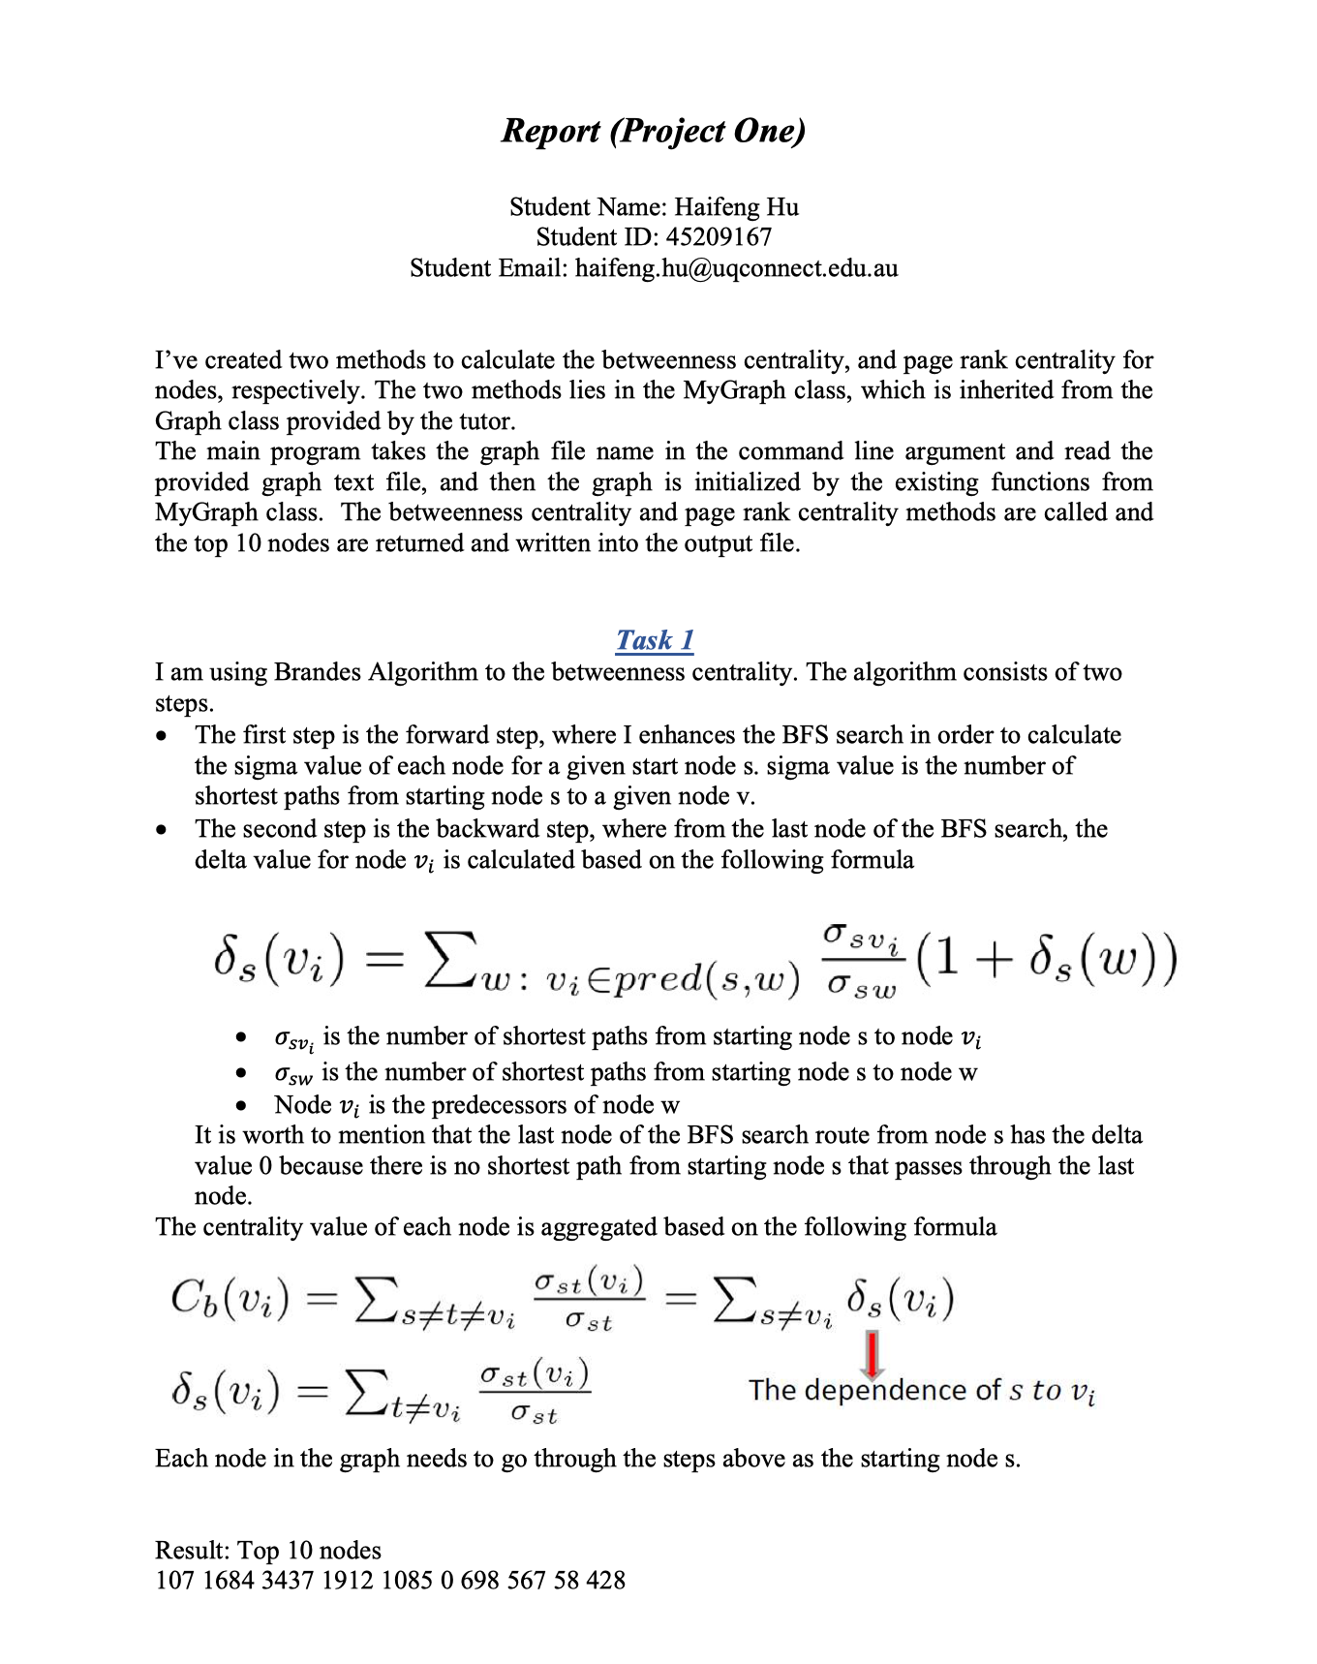
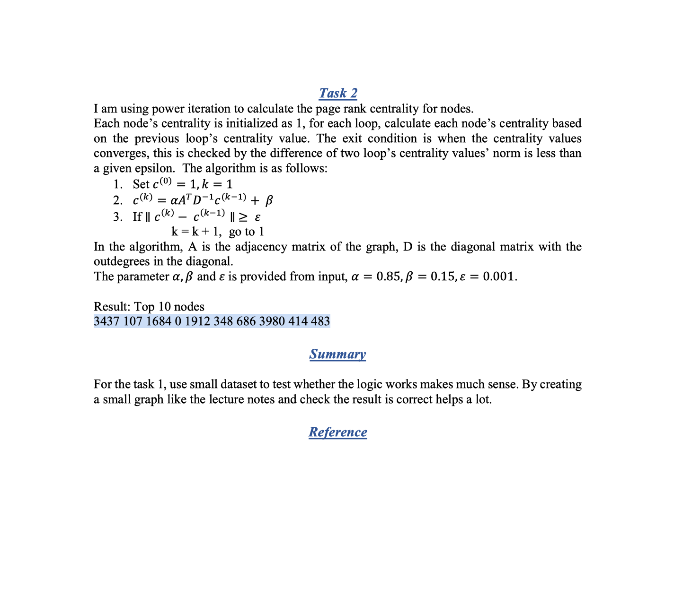
Some excellent work from our students!
Student: 45209167 Mr. Haifeng Hu
PART THREE: REPORT
Notes:
107, 1684, 3437, 1912, 1085, 0, 698, 567, 58, 428]
[3437, 107, 1684, 0, 1912, 348, 686, 3980, 414, 698]

Slide 18
Some excellent work from our students!
Student: 45209167 Mr. Haifeng Hu
Any shortcoming?
The result of task 2 has only one different node in 10th position, but I don’t think this should reduce my impression of this work. And according to our previous said, we will give the full remark.
Highlight?
The project source code gave me deep impression.
The report is brief but precise.
The results are good enough.
In summary, I’d like to give full mark of his project work
Notes:
107, 1684, 3437, 1912, 1085, 0, 698, 567, 58, 428]
[3437, 107, 1684, 0, 1912, 348, 686, 3980, 414, 698]

Slide 19
Graph Convolution Networks: A Spectral Method
Xiangguo Sun
sunxiangguodut@qq.com

Slide 20
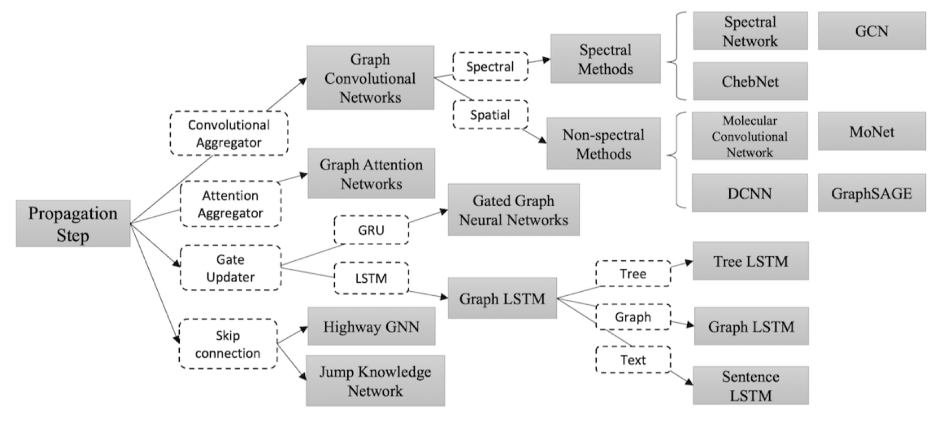

Slide 21

CNN

Slide 22
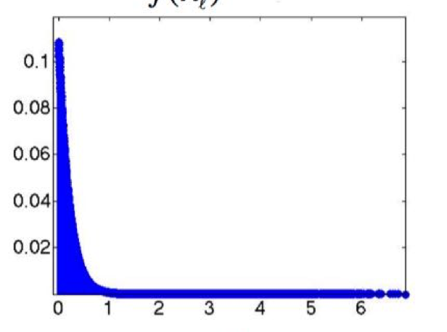
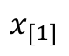
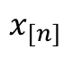
How about this?
Graph Convolution Networks in Spatial
Time series
Discrete Fourier Transform
…
$$x_{[1]}$$
$$x_{[n]}$$
time series

Slide 23
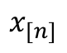
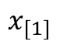
How about this?
Graph Convolution Networks in Spatial
Spatial domain
Spatial domain
How about this?
Graph Convolution Networks in Spectrum
$$x_{[n]}$$
Spectral domain
Spatial domain
$$x_{[1]}$$

Slide 24
Graph Convolution Networks in Spectrum
Prerequisite Knowledge
Fourier Transform
Graph Laplacian and its Properties
Graph Fourier Transform
Spectral Graph Convolution
Convolution Kernel
Notes:
prerequisite knowledge
Fourier Transform
Graph Laplacian and its Properties
Graph Fourier Transform: Graph Signal
Spectral Graph Convolution
Convolution Kernel

Slide 25
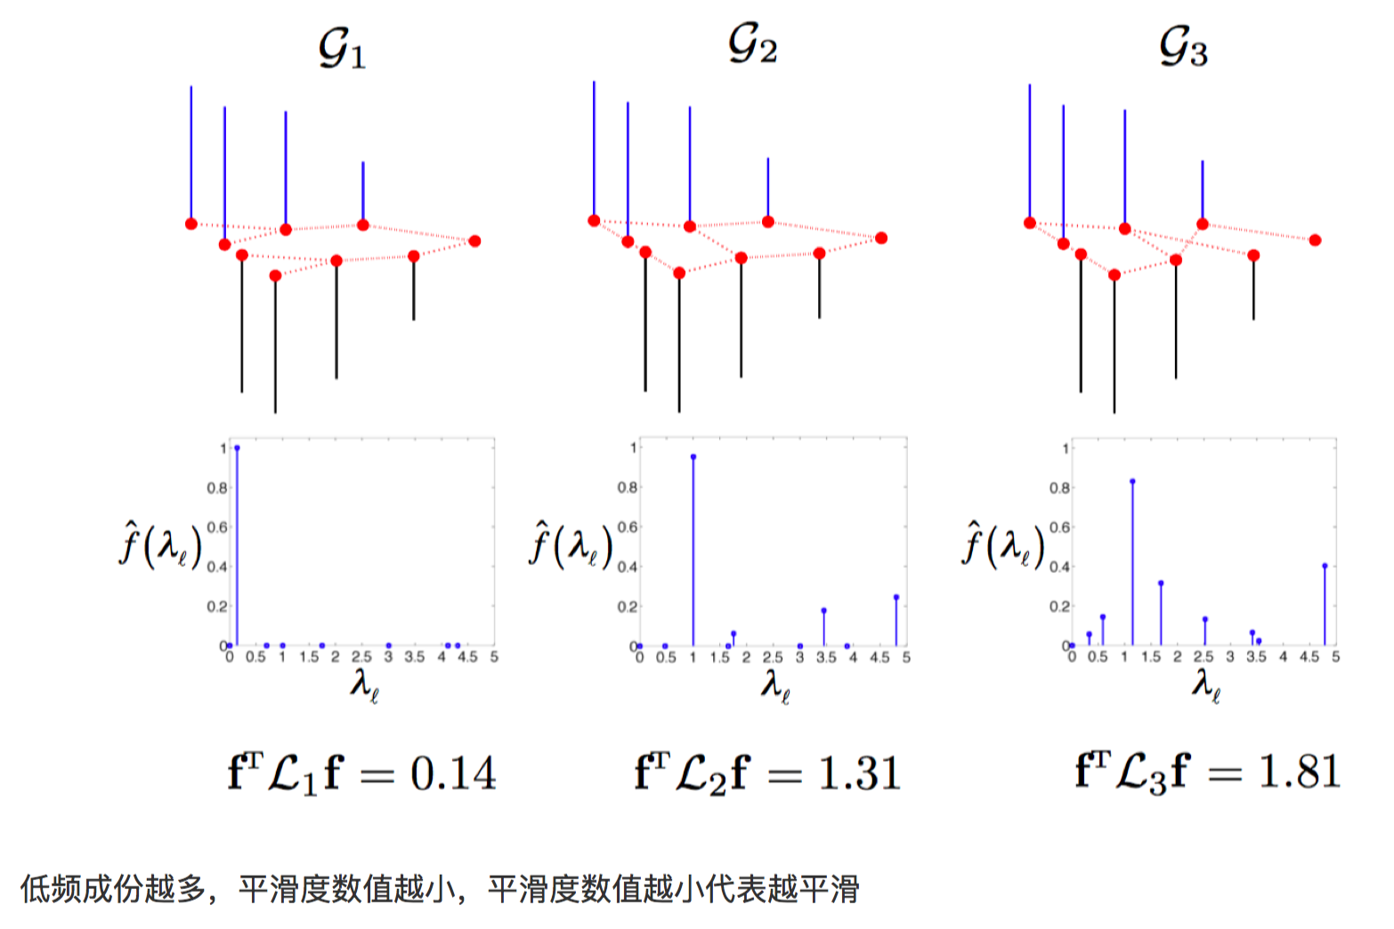
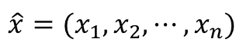
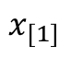
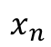
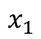
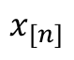
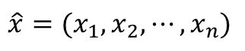
Prerequisite Knowledge
Graph signal
Time series
$$x_{1}$$
…
$$x_{[1]}$$
$$x_{[n]}$$
time series
$$x_{n}$$
$${\hat{x}=(x}_{1},x_{2},⋯,x_{n})$$
$${\hat{x}=(x}_{1},x_{2},⋯,x_{n})$$
Not sequence
sequence
Notes:
prerequisite knowledge
Fourier Transform
Graph Laplacian and its Properties
Graph Fourier Transform: Graph Signal
Spectral Graph Convolution
Convolution Kernel

Slide 26
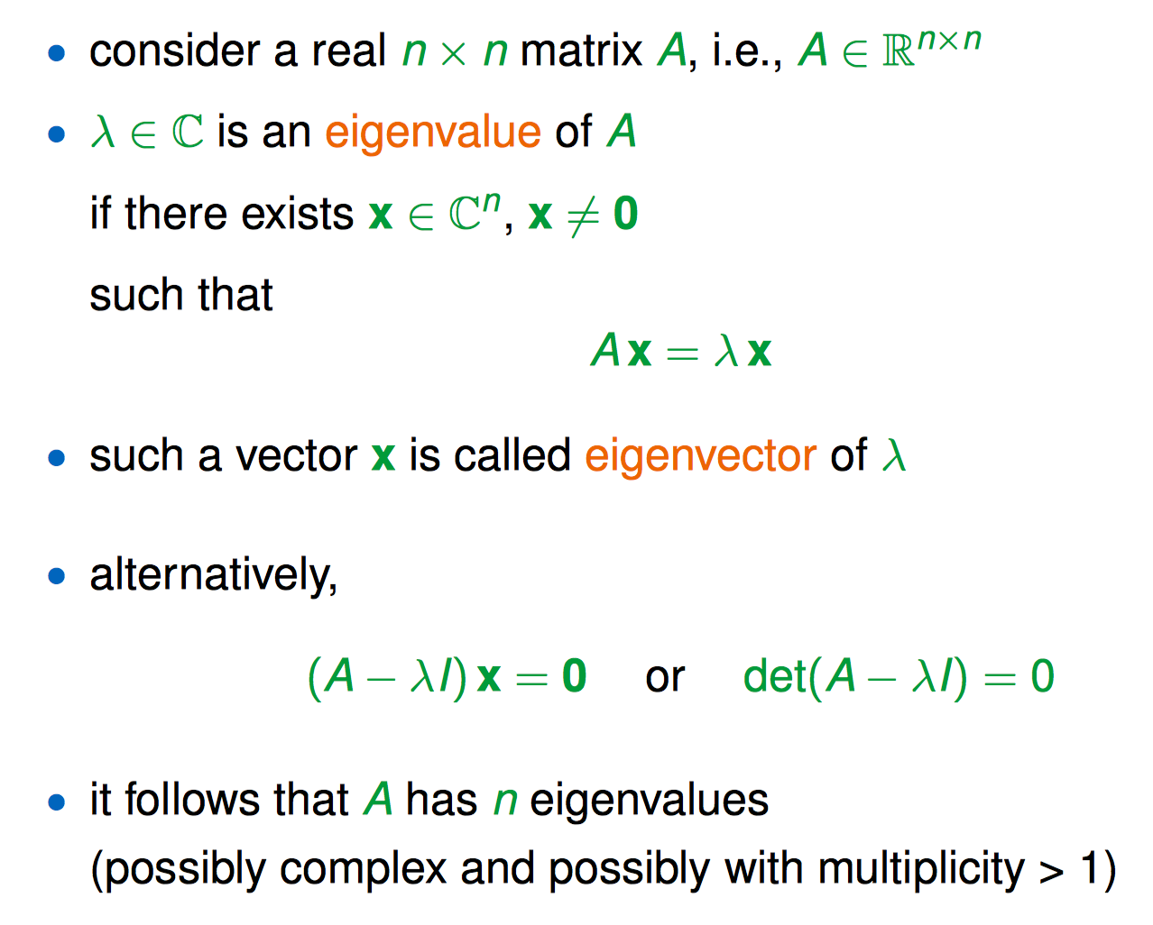
Prerequisite Knowledge
eigenvalues and eigenvectors
Notes:
prerequisite knowledge
Fourier Transform
Graph Laplacian and its Properties
Graph Fourier Transform: Graph Signal
Spectral Graph Convolution
Convolution Kernel

Slide 27
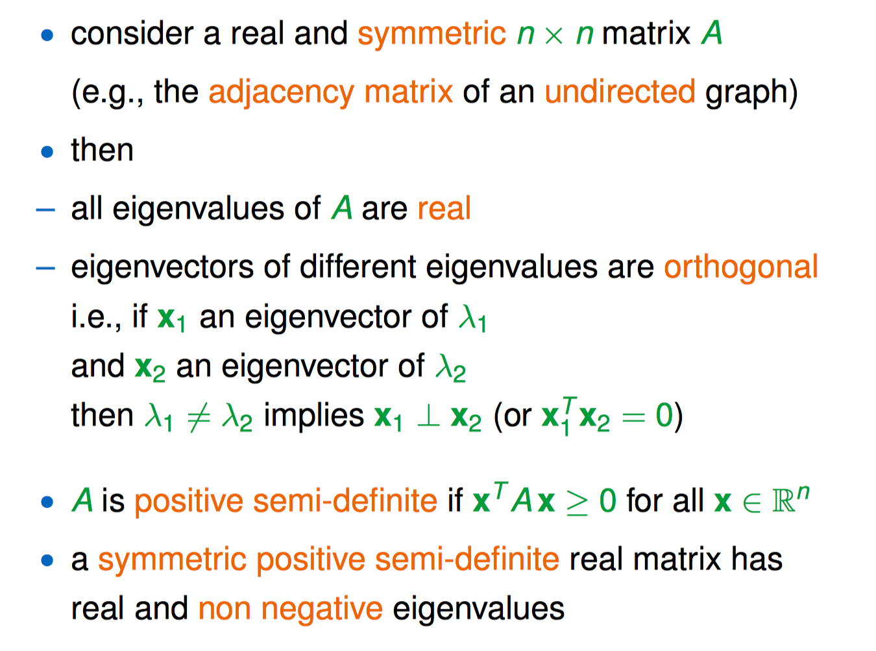
Prerequisite Knowledge
eigenvalues and eigenvectors
Notes:
prerequisite knowledge
Fourier Transform
Graph Laplacian and its Properties
Graph Fourier Transform: Graph Signal
Spectral Graph Convolution
Convolution Kernel

Slide 28
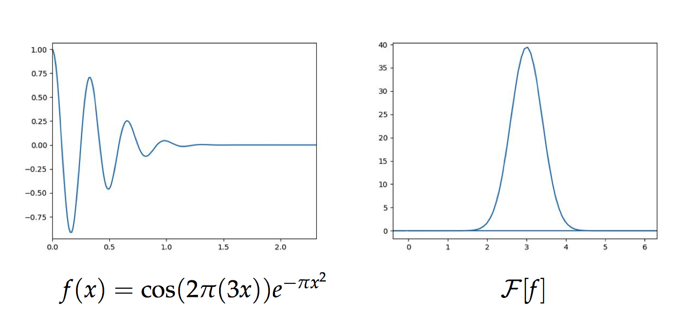
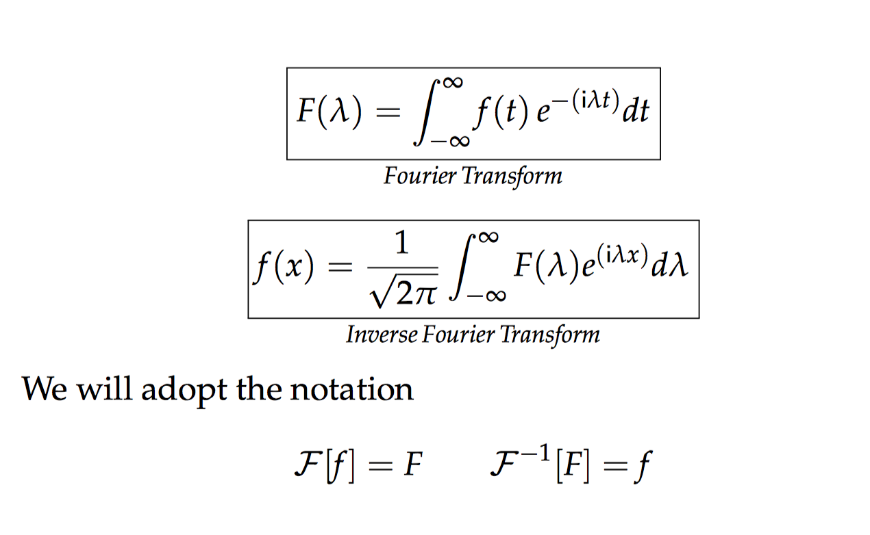
Fourier Transform
Notes:
prerequisite knowledge
Fourier Transform
Graph Laplacian and its Properties
Graph Fourier Transform: Graph Signal
Spectral Graph Convolution
Convolution Kernel

Slide 29
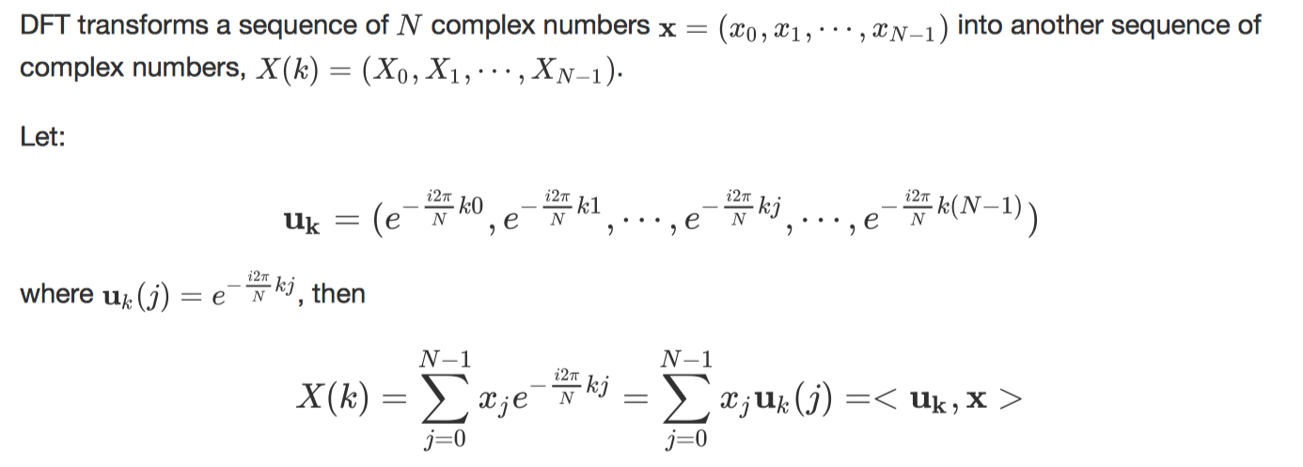
Discrete
Fourier Transform
Fourier basis
Notes:
prerequisite knowledge
Fourier Transform
Graph Laplacian and its Properties
Graph Fourier Transform: Graph Signal
Spectral Graph Convolution
Convolution Kernel

Slide 30
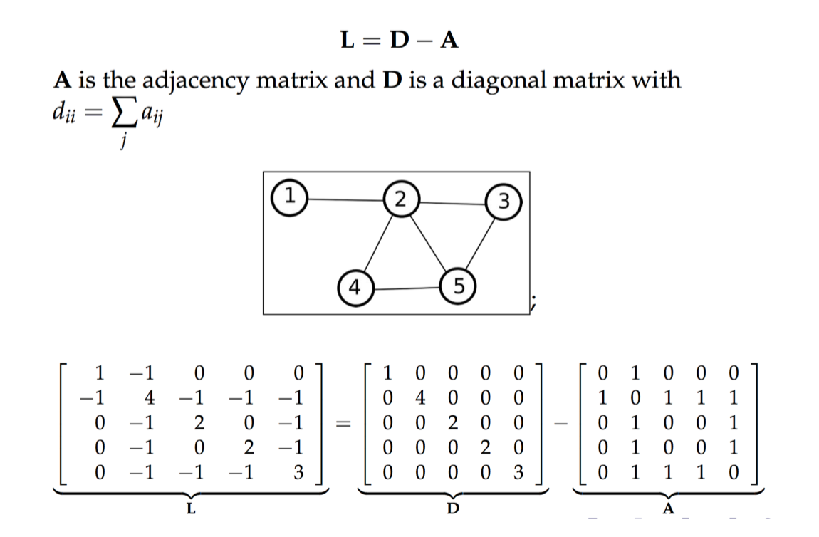
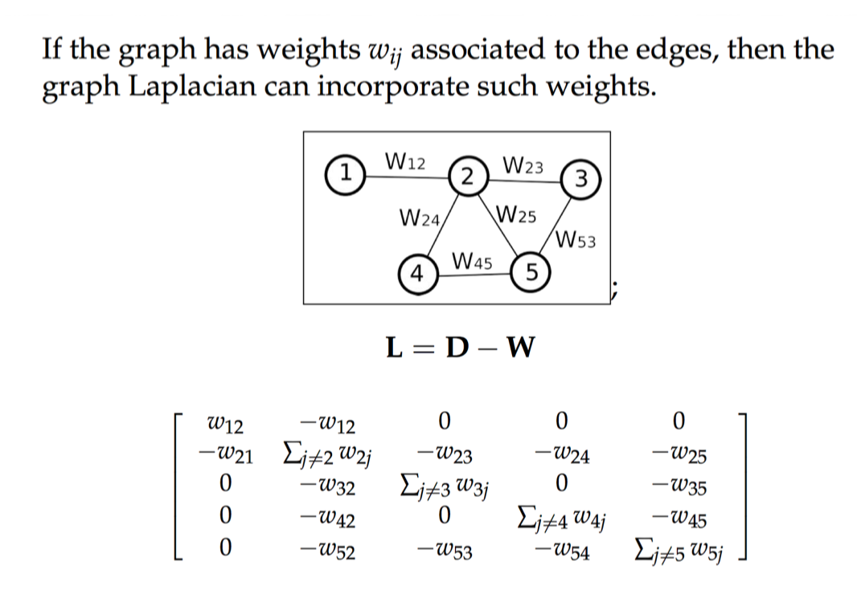
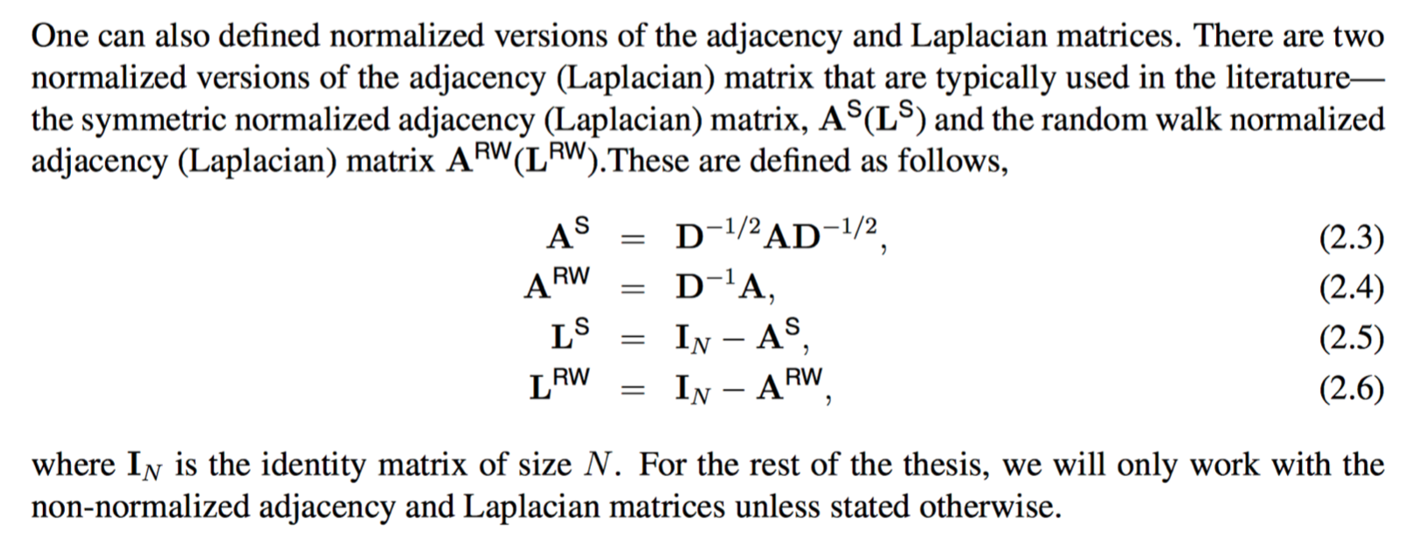
Graph Laplacian and its Properties
Notes:
prerequisite knowledge
Fourier Transform
Graph Laplacian and its Properties
Graph Fourier Transform: Graph Signal
Spectral Graph Convolution
Convolution Kernel

Slide 31
Graph Laplacian and its Properties
Notes:
prerequisite knowledge
Fourier Transform
Graph Laplacian and its Properties
Graph Fourier Transform: Graph Signal
Spectral Graph Convolution
Convolution Kernel

Slide 32
Graph Laplacian and its Properties
Notes:
prerequisite knowledge
Fourier Transform
Graph Laplacian and its Properties
Graph Fourier Transform: Graph Signal
Spectral Graph Convolution
Convolution Kernel

Slide 33
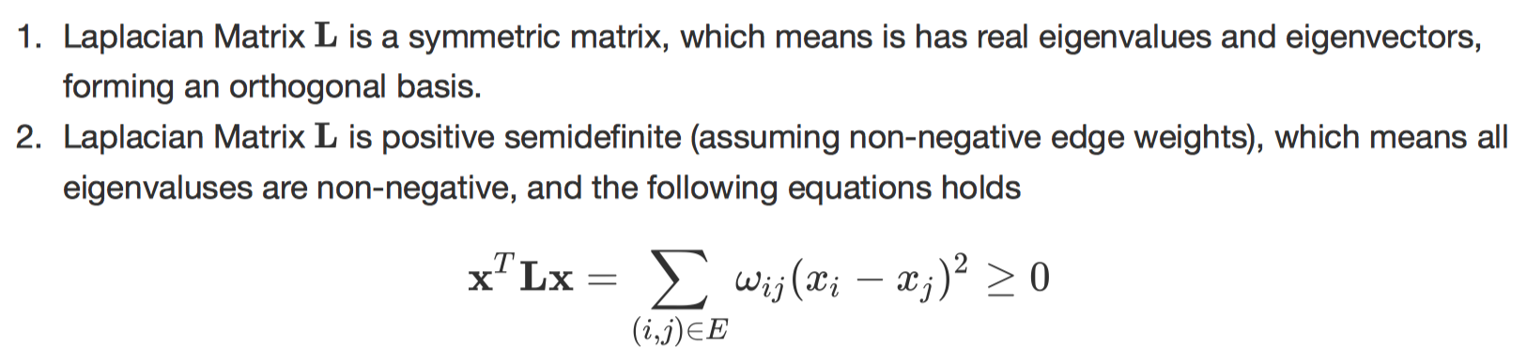
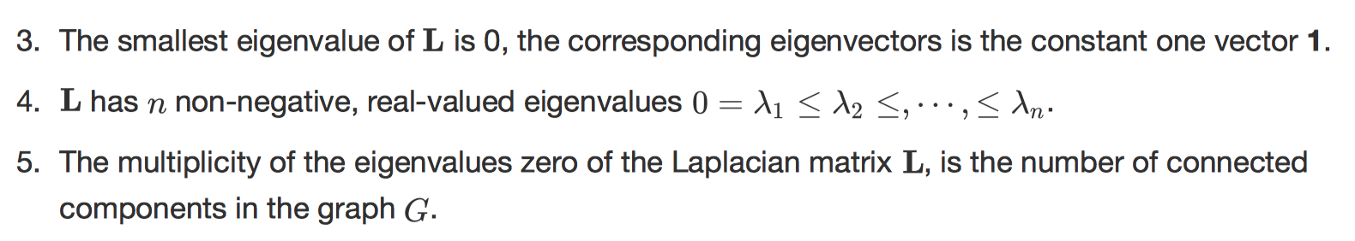
Graph Laplacian and its Properties
Notes:
prerequisite knowledge
Fourier Transform
Graph Laplacian and its Properties
Graph Fourier Transform: Graph Signal
Spectral Graph Convolution
Convolution Kernel

Slide 34
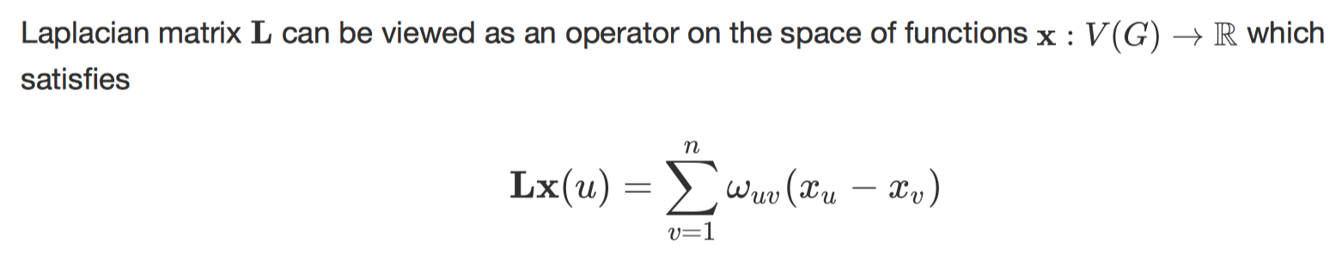
Graph Laplacian and its Properties
Laplacian matrix has another name Laplacian Operator, denoted by $Δ$.
The output of this operation essentially retains weighted diﬀerences of signal values on each node with respect to their neighboring nodes.
Notes:
prerequisite knowledge
Fourier Transform
Graph Laplacian and its Properties
Graph Fourier Transform: Graph Signal
Spectral Graph Convolution
Convolution Kernel

Slide 35
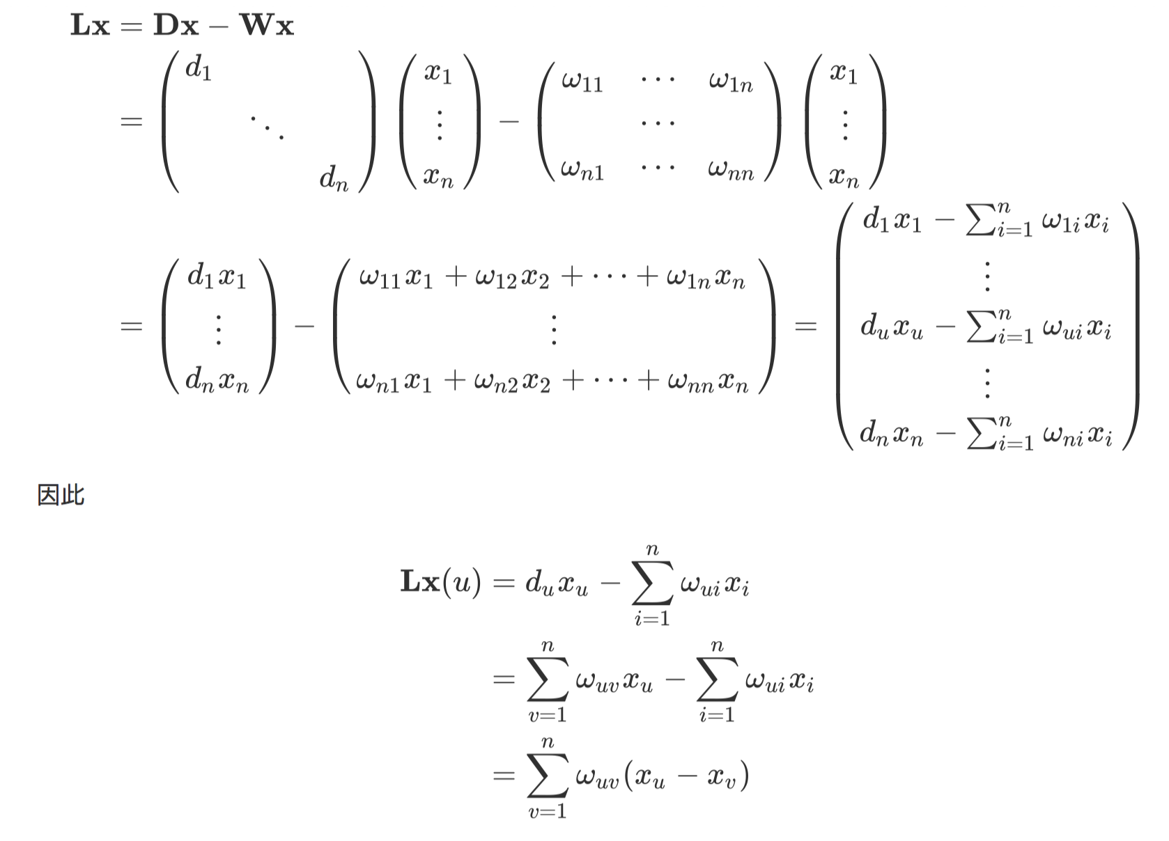
Graph Laplacian and its Properties
Notes:
prerequisite knowledge
Fourier Transform
Graph Laplacian and its Properties
Graph Fourier Transform: Graph Signal
Spectral Graph Convolution
Convolution Kernel

Slide 36
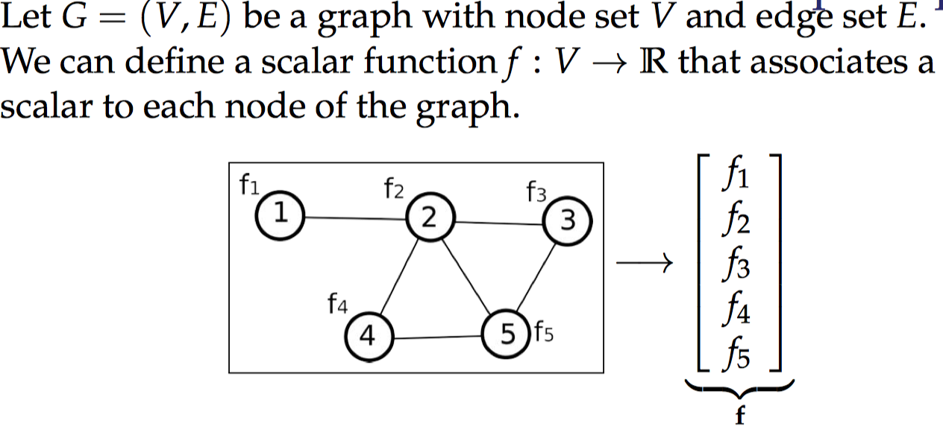
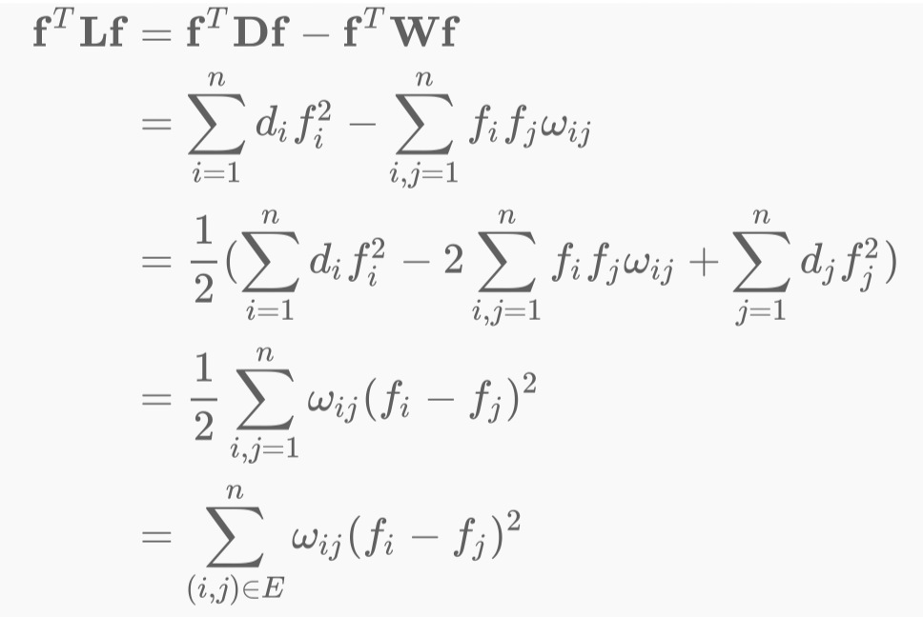
Graph Laplacian and its Properties
Notes:
prerequisite knowledge
Fourier Transform
Graph Laplacian and its Properties
Graph Fourier Transform: Graph Signal
Spectral Graph Convolution
Convolution Kernel

Slide 37

Graph Laplacian and its Properties
This is so called the Smoothness Function on a Graph
Notes:
prerequisite knowledge
Fourier Transform
Graph Laplacian and its Properties
Graph Fourier Transform: Graph Signal
Spectral Graph Convolution
Convolution Kernel

Slide 38
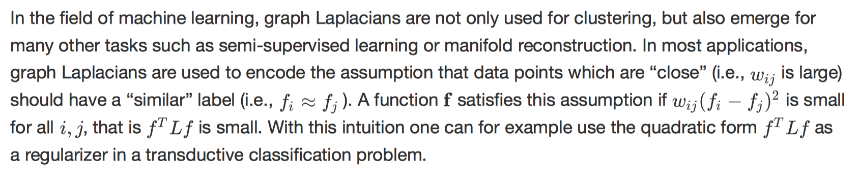
Graph Laplacian and its Properties
This is so called the Smoothness Function on a Graph
Notes:
prerequisite knowledge
Fourier Transform
Graph Laplacian and its Properties
Graph Fourier Transform: Graph Signal
Spectral Graph Convolution
Convolution Kernel

Slide 39
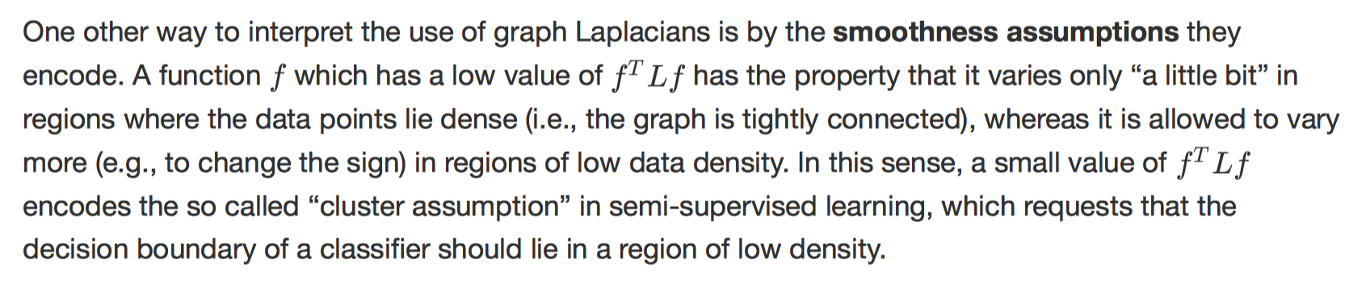
Graph Laplacian and its Properties
This is so called the Smoothness Function on a Graph
Notes:
prerequisite knowledge
Fourier Transform
Graph Laplacian and its Properties
Graph Fourier Transform: Graph Signal
Spectral Graph Convolution
Convolution Kernel

Slide 40
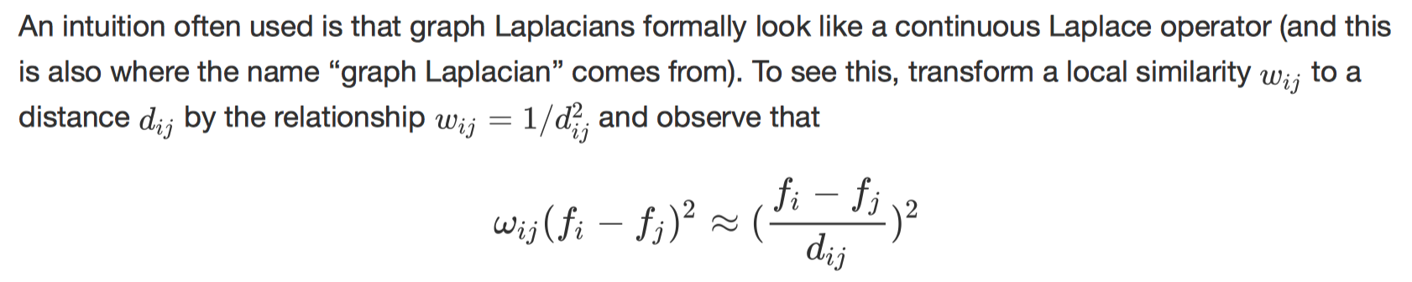
Graph Laplacian and its Properties
This is so called the Smoothness Function on a Graph
Notes:
prerequisite knowledge
Fourier Transform
Graph Laplacian and its Properties
Graph Fourier Transform: Graph Signal
Spectral Graph Convolution
Convolution Kernel

Slide 41


Graph Laplacian and its Properties
More lower frequencies, more smooth
Compare subgraph structures from their frequency spectrum
Smoothness of a graph signal
Notes:
prerequisite knowledge
Fourier Transform
Graph Laplacian and its Properties
Graph Fourier Transform: Graph Signal
Spectral Graph Convolution
Convolution Kernel

Slide 42
Graph Fourier Transform
What’s the so called “frequency” on a Graph exactly means?
Notes:
prerequisite knowledge
Fourier Transform
Graph Laplacian and its Properties
Graph Fourier Transform: Graph Signal
Spectral Graph Convolution
Convolution Kernel

Slide 43
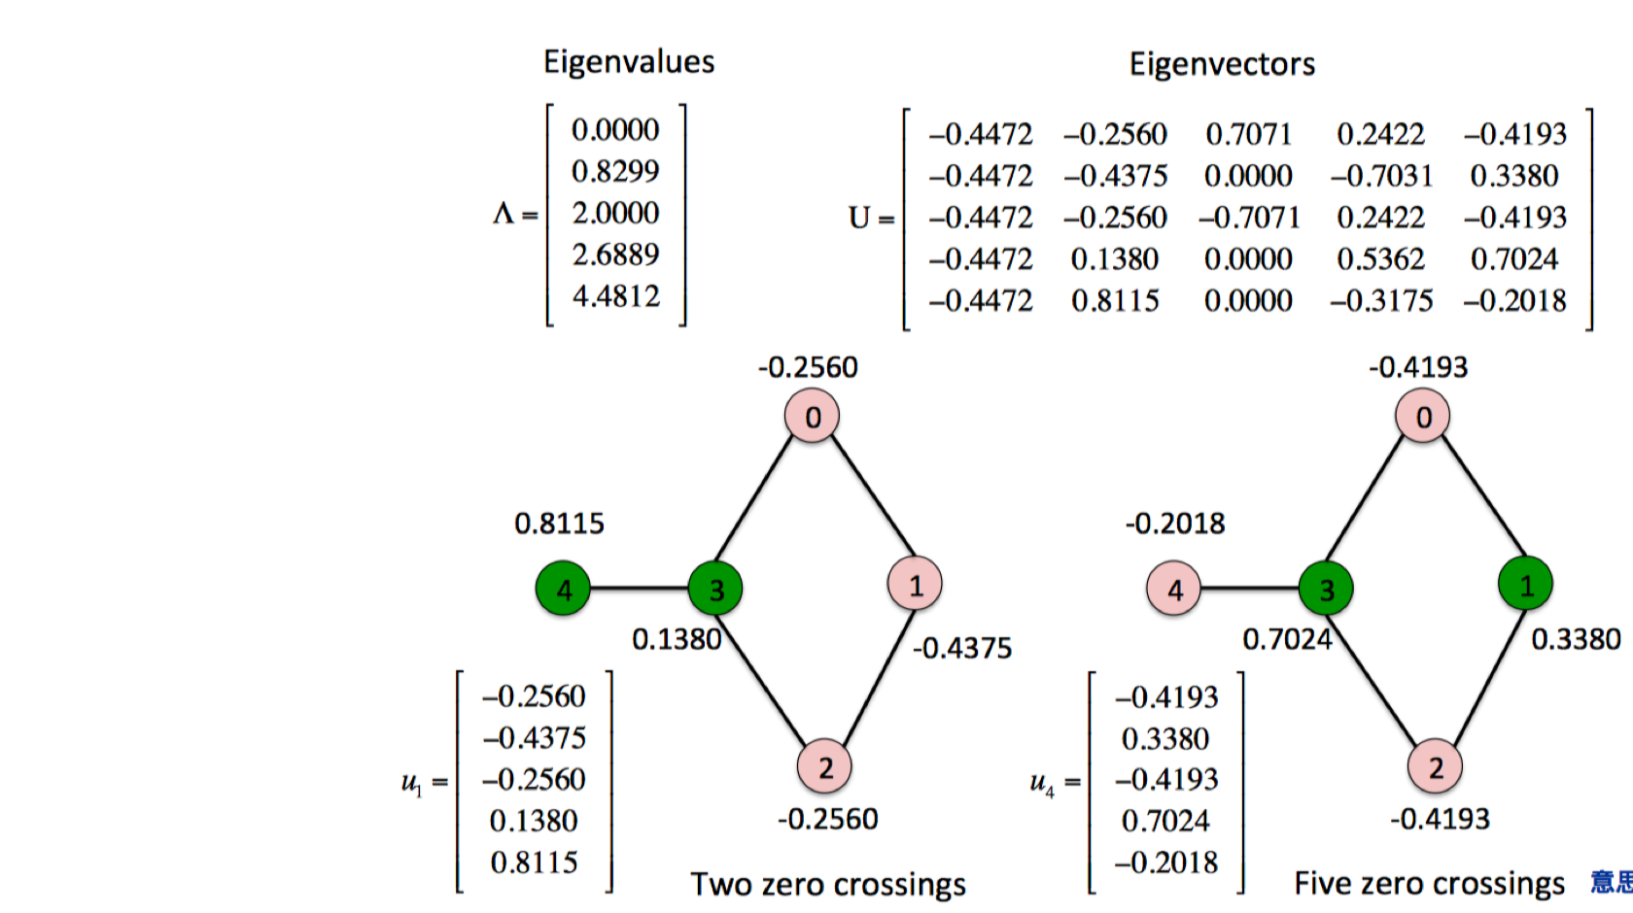
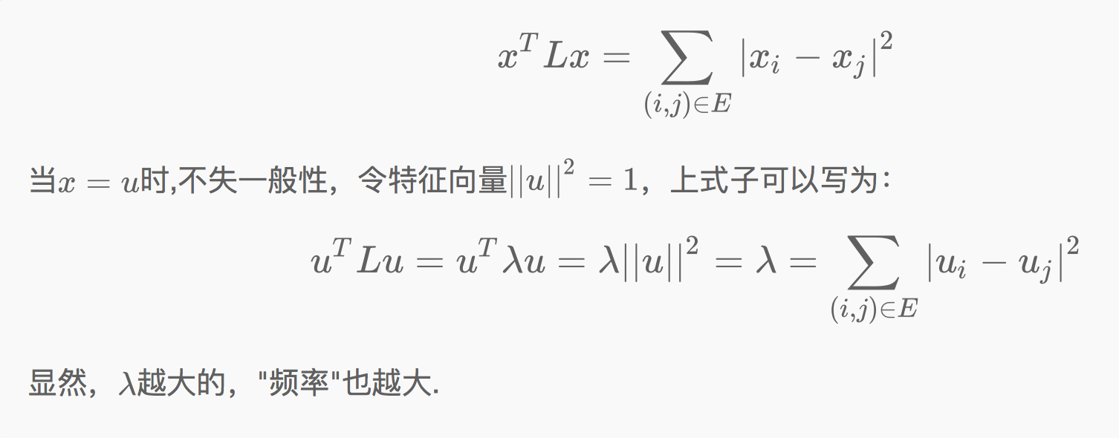
Graph Fourier Transform
What’s the so called “frequency” on a Graph exactly means?
Notes:
prerequisite knowledge
Fourier Transform
Graph Laplacian and its Properties
Graph Fourier Transform: Graph Signal
Spectral Graph Convolution
Convolution Kernel

Slide 44
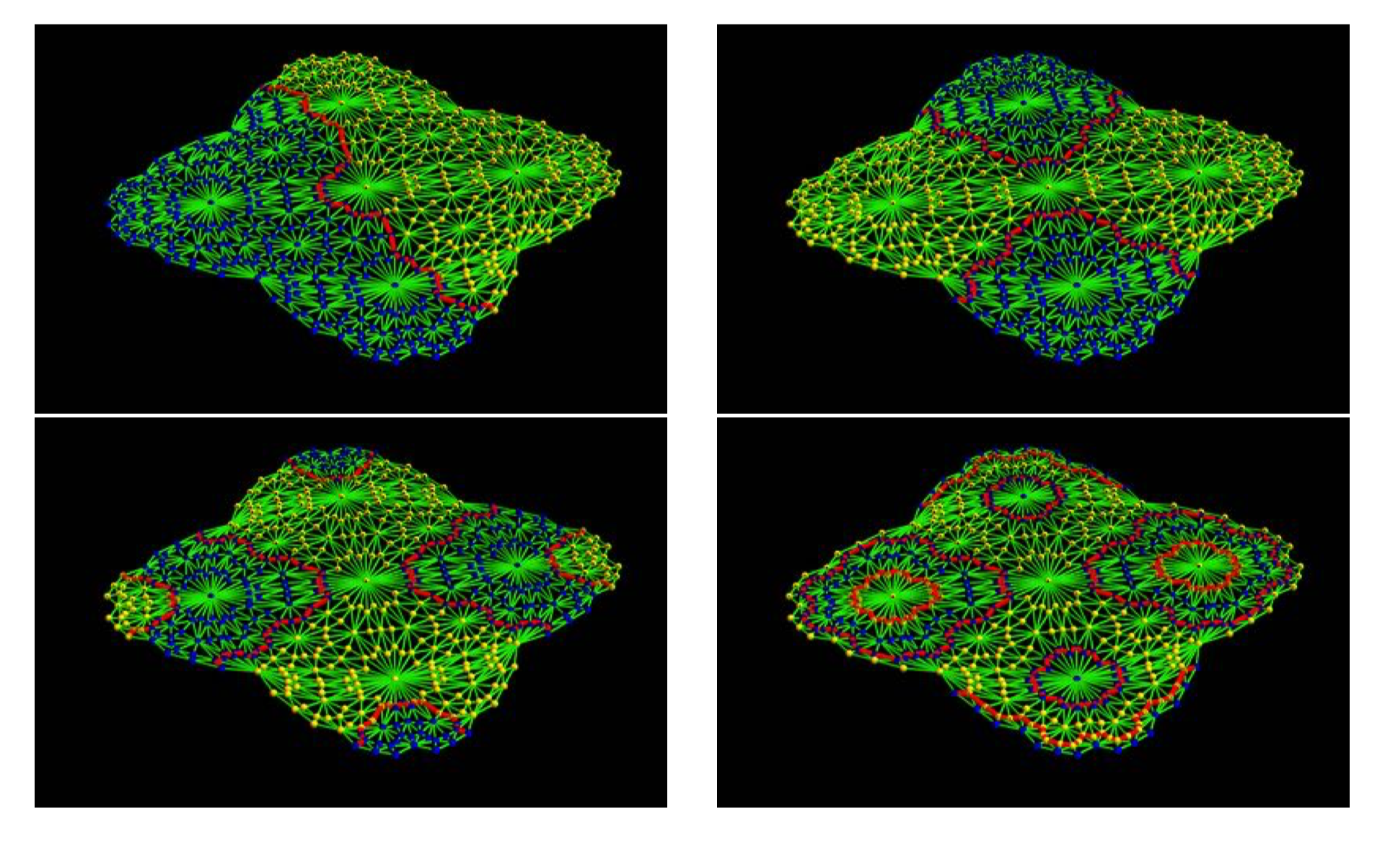
Graph Fourier Transform
Notes:
prerequisite knowledge
Fourier Transform
Graph Laplacian and its Properties
Graph Fourier Transform: Graph Signal
Spectral Graph Convolution
Convolution Kernel

Slide 45
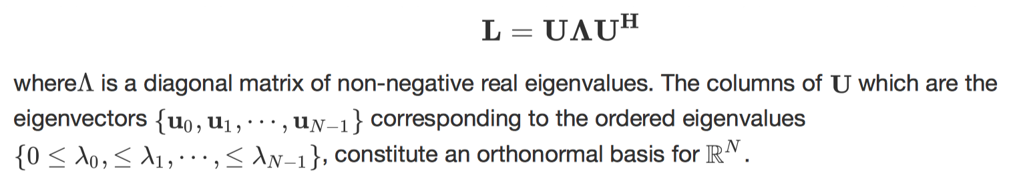
Graph Fourier Transform
Notes:
prerequisite knowledge
Fourier Transform
Graph Laplacian and its Properties
Graph Fourier Transform: Graph Signal
Spectral Graph Convolution
Convolution Kernel

Slide 46
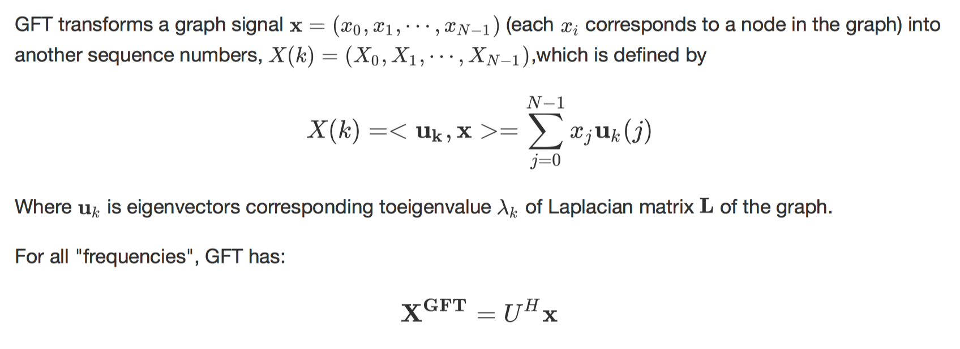


Graph Fourier Transform
In summary, the eigenvalues of $L$ play the role of frequencies and the eigenvectors the Fourier basis
Notes:
prerequisite knowledge
Fourier Transform
Graph Laplacian and its Properties
Graph Fourier Transform: Graph Signal
Spectral Graph Convolution
Convolution Kernel

Slide 47




Graph Fourier Transform
This analogy can also happened in the DTFT or CTFT
CTFT
DFT
DTFT
GFT
Notes:
prerequisite knowledge
Fourier Transform
Graph Laplacian and its Properties
Graph Fourier Transform: Graph Signal
Spectral Graph Convolution
Convolution Kernel

Slide 48

Spectral Graph Convolution
Notes:
prerequisite knowledge
Fourier Transform
Graph Laplacian and its Properties
Graph Fourier Transform: Graph Signal
Spectral Graph Convolution
Convolution Kernel

Slide 49


Spectral Graph Convolution
Notes:
prerequisite knowledge
Fourier Transform
Graph Laplacian and its Properties
Graph Fourier Transform: Graph Signal
Spectral Graph Convolution
Convolution Kernel

Slide 50

Spectral Graph Convolution
Notes:
prerequisite knowledge
Fourier Transform
Graph Laplacian and its Properties
Graph Fourier Transform: Graph Signal
Spectral Graph Convolution
Convolution Kernel

Slide 51

Spectral Graph Convolution
Notes:
prerequisite knowledge
Fourier Transform
Graph Laplacian and its Properties
Graph Fourier Transform: Graph Signal
Spectral Graph Convolution
Convolution Kernel

Slide 52

Spectral Graph Convolution
Are you OK?
Notes:
prerequisite knowledge
Fourier Transform
Graph Laplacian and its Properties
Graph Fourier Transform: Graph Signal
Spectral Graph Convolution
Convolution Kernel

Slide 53



Spectral Graph Convolution
Notes:
prerequisite knowledge
Fourier Transform
Graph Laplacian and its Properties
Graph Fourier Transform: Graph Signal
Spectral Graph Convolution
Convolution Kernel

Slide 54

Spectral Graph Convolution
Notes:
prerequisite knowledge
Fourier Transform
Graph Laplacian and its Properties
Graph Fourier Transform: Graph Signal
Spectral Graph Convolution
Convolution Kernel

Slide 55

Spectral Graph Convolution
Notes:
prerequisite knowledge
Fourier Transform
Graph Laplacian and its Properties
Graph Fourier Transform: Graph Signal
Spectral Graph Convolution
Convolution Kernel

Slide 56

Spectral Graph Convolution
Notes:
prerequisite knowledge
Fourier Transform
Graph Laplacian and its Properties
Graph Fourier Transform: Graph Signal
Spectral Graph Convolution
Convolution Kernel

Slide 57


Spectral Graph Convolution
=
Notes:
prerequisite knowledge
Fourier Transform
Graph Laplacian and its Properties
Graph Fourier Transform: Graph Signal
Spectral Graph Convolution
Convolution Kernel

Slide 58

Spectral Graph Convolution
Graph Neural Networks: A Review of Methods and Applications
Notes:
prerequisite knowledge
Fourier Transform
Graph Laplacian and its Properties
Graph Fourier Transform: Graph Signal
Spectral Graph Convolution
Convolution Kernel

Slide 59

Convolution Kernel
Notes:
prerequisite knowledge
Fourier Transform
Graph Laplacian and its Properties
Graph Fourier Transform: Graph Signal
Spectral Graph Convolution
Convolution Kernel

Slide 60

Convolution Kernel
Notes:
prerequisite knowledge
Fourier Transform
Graph Laplacian and its Properties
Graph Fourier Transform: Graph Signal
Spectral Graph Convolution
Convolution Kernel

Slide 61

Convolution Kernel
Notes:
prerequisite knowledge
Fourier Transform
Graph Laplacian and its Properties
Graph Fourier Transform: Graph Signal
Spectral Graph Convolution
Convolution Kernel

Slide 62

Convolution Kernel
Notes:
prerequisite knowledge
Fourier Transform
Graph Laplacian and its Properties
Graph Fourier Transform: Graph Signal
Spectral Graph Convolution
Convolution Kernel

Slide 63



Convolution Kernel
Notes:
prerequisite knowledge
Fourier Transform
Graph Laplacian and its Properties
Graph Fourier Transform: Graph Signal
Spectral Graph Convolution
Convolution Kernel

Slide 64
Convolution Kernel
Notes:
prerequisite knowledge
Fourier Transform
Graph Laplacian and its Properties
Graph Fourier Transform: Graph Signal
Spectral Graph Convolution
Convolution Kernel

Slide 65
Convolution Kernel
Notes:
prerequisite knowledge
Fourier Transform
Graph Laplacian and its Properties
Graph Fourier Transform: Graph Signal
Spectral Graph Convolution
Convolution Kernel

Slide 66

Convolution Kernel
The following papers all mention spectral graph convolution operation with their own designed kernels:
M. Henaﬀ, J. Bruna, and Y. Lecun, “Deep convolutional networks on graph-structured data.” arXiv: Learning, 2015.
D. K. Hammond, P. Vandergheynst, and R. Gribonval, “Wavelets on graphs via spectral graph theory,” Applied and Computational Harmonic Analysis, vol. 30, no. 2, pp. 129–150, 2011.
M. Deﬀerrard, X. Bresson, and P. Vandergheynst, “Convolutional neural networks on graphs with fast localized spectral ﬁltering,” NIPS 2016, pp. 3844–3852, 2016.
T. N. Kipf and M. Welling, “Semi-supervised classiﬁcation with graph convolutional networks,” ICLR 2017, 2017.
Y. C. Ng, N. Colombo, and R. Silva, “Bayesian semi-supervised learning with graph gaussian processes,” in NeurIPS 2018, 2018, pp. 1690–1701.
Notes:
prerequisite knowledge
Fourier Transform
Graph Laplacian and its Properties
Graph Fourier Transform: Graph Signal
Spectral Graph Convolution
Convolution Kernel

Slide 67

Further Reading
Lectures
1. Spectral graph analysis, Aristides Gionis
2. Graph Signal Processing, Prof. Luis Gustavo Nonato
3. Spectral Graph Theory, Lecture 5, David P. Willianmson
4. Lectures on Spectral Graph Theory，Fan R. K. Chung
5. Harmonic Analysis on Graphs and Networks, Pierre Vandergheynst
6. Spectral Convolution Networks, Maria Francesca, Arthur Hughes, David Gregg
Websites
1. https://en.wikipedia.org/wiki/Discrete_Fourier_transform
2. https://www.zhihu.com/question/22085329
3. https://www.cnblogs.com/pinard/p/6221564.html
4. https://en.wikipedia.org/wiki/Laplace_operator
5. https://en.wikipedia.org/wiki/Algebraic_connectivity
6. https://en.wikipedia.org/wiki/Discrete_Laplace_operator
7. https://blog.csdn.net/chensi1995/article/details/77232019
Books
1. Pattern Recognition and Machine Learning,
2. Graph Structured Data Viewed Through a Fourier Lens, Venkatesan Ekambaram, Page 13
Discrete nodal domain theorems. Linear Algebra and its Applications, 336(1):51–60, 2001.
4. Spectral graph theory, Daniel Spielman
5. Matrix analysis and applied linear algebra,Carl D Meyer
References
Papers
1. Graph Neural Networks: A Review of Methods and Applications, Zhou, Jie.
2. Discrete signal processing on graphs graph fourier transform, Aliaksei Sandryhaila
3. A tutorial on spectral clustering, Ulrike von Luxburg
4. Discrete Signal Processing on Graphs, Aliaksei Sandryhaila
5. Deep Convolutional Networks on Graph structured data, Mikael Henaﬀ
6. Semi-supervised classiﬁcation with graph convolutional networks, Thomas N.Kipf
7. Spectral convolution networks, Maria Francesca
8. Deep collective classiﬁcation in heterogeneous information networks, Yizhou Zhang
9. Spectral networks and locally connected networks on graphs, Joan Bruna
Notes:
prerequisite knowledge
Fourier Transform
Graph Laplacian and its Properties
Graph Fourier Transform: Graph Signal
Spectral Graph Convolution
Convolution Kernel

Slide 68



See you next week☺
May you smile like a child

